Slide 1
Epigenetic differences between CD8 populations in T1D patients
5-23-24 SI meeting
Ty Bottorff – Bioinformatics postdoc
Linsley lab
Notes:
P576-1 - ITN ATAC study - Better defining T_{ex} in teplizumab-treated subjects to inform combination treatments
Teplizumab: humanized anti-CD3 monoclonal Ab to delay onset of stage 3 T1D in people with stage 2 T1D. mechanism: weak agonist of TCR-CD3 to induce anergy/apoptosis of T cells (i.e. autoreactive Teffs I presume)
ATACseq relies on transposase that cuts and adds seq adaptors, prefers accessible chromatin

Slide 2
Outline
Background on T_{ex} and T1D
Brief QC
Preliminary results

Slide 3
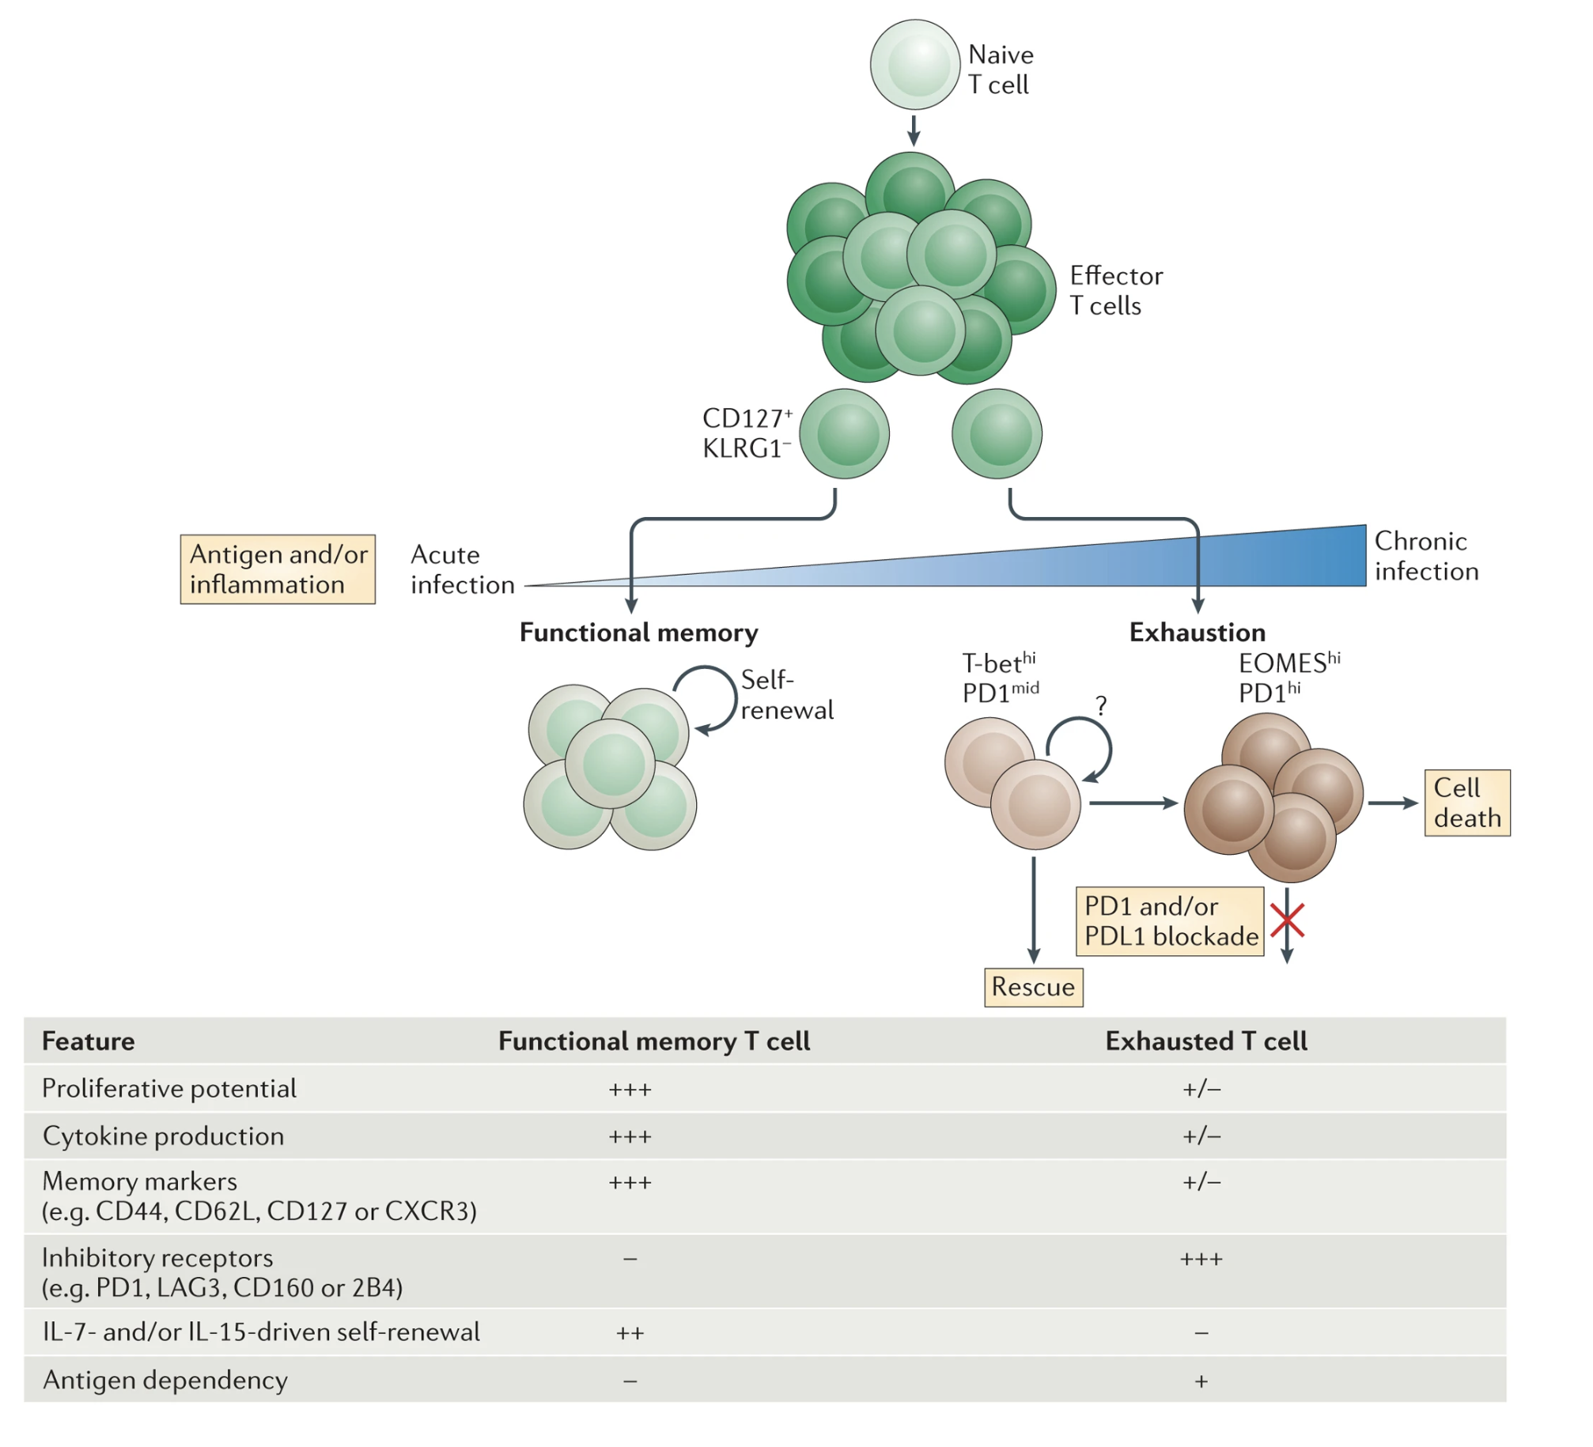
T cell exhaustion results from chronic antigen stimulation, inability to fully clear antigen
Specific TFs (EOMES, TOX) expressed as well
Wherry & Kurachi. Nat Reviews Immunol. 2015
Notes:
Tex cells lack open chromatin sites in *Ifng* locus in Teff/TEM cells, Tex cells have open chromatin sites in *Pdcd1* locus (PD1), i.e. Teff down IR up it tracks
This green is non-exhausted CD127+
Autoimmunity still results likely because affinity between antigens and TCRs are low, so T cells don’t become overly exhausted (i.e. higher affinity TCR-neoantigens more strongly stimulate T cells and exhausts them)
With weakly stimulated but chronic antigens, T cells don’t exhaust (i.e. autoimmunity)
So in case of autoimmunity this is great, in case of cancer it associates with worse response
3 signal model for exhaustion: persistent antigen exposure, negative costimulatory signals, chronic inflammation
Evolutionary reason for Tex could be to minimize self-tissue damage with still controlling antigen somewhat
More and more exhaustion leads to terminal exhaustion & apoptosis

Slide 4
Levels of T_{ex} are a biomarker in T1D
Higher levels of (partial) T_{ex} (TIGIT⁺ KLRG1⁺) CD8s associated with
slower progression to T1D
teplizumab and alefacept responses
beneficial response to therapy in at risk for and new onset T1D
Higher levels of TIGIT⁺KLRG1⁺CD127⁺ CD8s associated with worse outcome
Phenotype of islet-reactive CD8s is more so T_{eff}, less so T_{ex}
Figure 2. Individuals with high levels of different Tex subsets vary in their clinical outcomes after teplizumab treatment. We stratified teplizumab- treated (Active) subjects from the TN-10 study having high (above third quartile) or low (below third quartile) levels of the indicated Tex subsets at 3 months post-treatment. We then used Kaplan-Meier survival analysis to compare time to T1D progression for these groups. As a negative control, we used as placebo- treated subjects.
Notes:
TIGIT⁺KLRG1⁺ Tex cells here are only partially exhausted (addition of TIGIT ligand further downregulates their activity)
Teplizumab: first FDA approved therapeutic for T1D therapy!
3 signal model for exhaustion: persistent antigen exposure, negative costimulatory signals, chronic inflammation
TEX are heterogeneous, with some TEX associating with better or worse outcome in cancer/chronic infection! So not always positive correlation b/w Tex and intensity of autoimmunity?
TIGIT+KLRG1+ only partially exhausted, ie there are more exhaustion markers

Slide 5
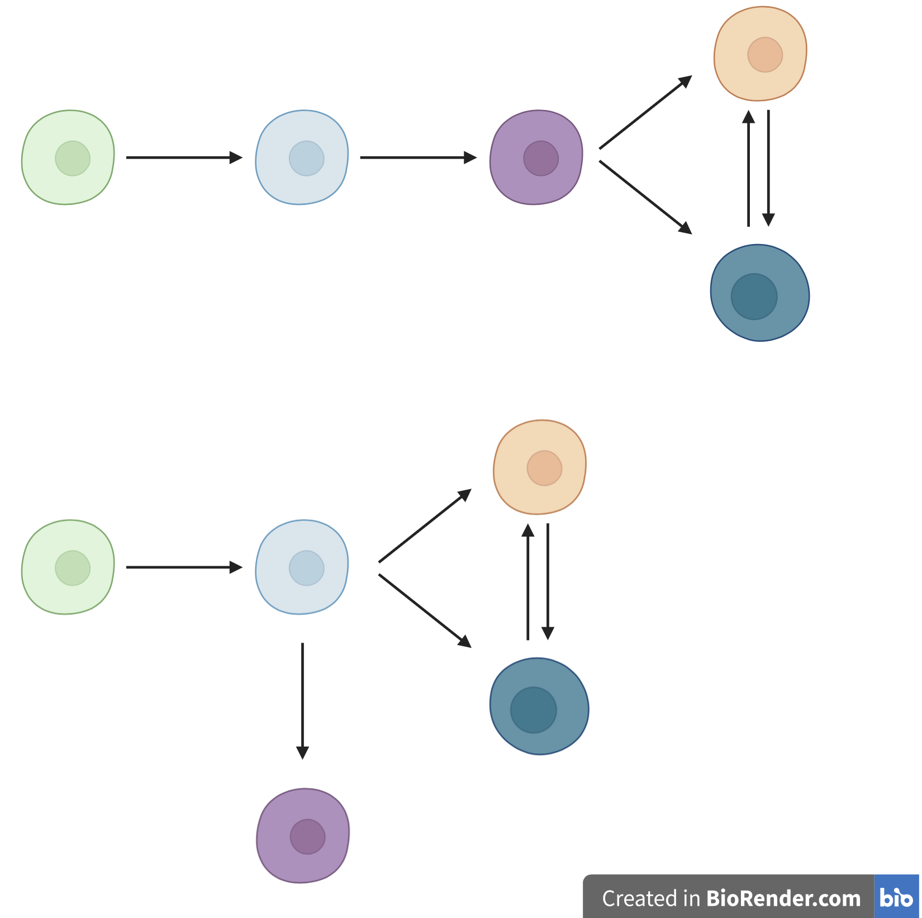
Central questions
1. Are PD-1⁺ and CD57⁺ T_{ex} epigenetically exhausted yet distinct here in teplizumab-treated subjects as observed with alefacept in TIDAL (Witkop, Commun Biol)?
2. How do the different cell populations’ epigenetic profiles differ?
3. What insights can we gain into CD8 TEM differentiation paths?
CD8 TEM differentiation models
DP PD-1⁺
DP
CD127⁺
TIGIT⁻
KLRG1⁻
TIGIT⁺
KLRG1⁺ (DP)
DP CD57⁺
Notes:
Hypothesis: beneficial teplizumab response mediated by expansion of specific populations of T_{ex}, T_{ex} heterogeneity may relate to response
Separate lineages is an oversimplification, likely overlapping populations (this is what we mean by heterogeneity)
PD1 and CD57 Tex are both hypo-proliferative andexpress IR in T1DAL study (alefacept)
TCR junction sequence identity between CD57+ and PD-1+ Tex, suggesting shared clonal relationships (fluid, bidirectional)
Both PD1+ and CD57+ Tex subsets share phenotypic (hypoproliferation, IR expression) and epigenetic signatures of Tex, with CD57 Tex having more open chromatin in lytic and KIR regulatory genes (Witkop, Commun Biol in revision)
CD57⁺ (also high for NK associated genes), marker of cytotoxic function
PD1 is an IR/activation marker
Motivation for point 2:
PD-1+ associated with better outcome
CD127+ associated with worse outcome
Point #1: i.e. are some more Tex?
T1DAL: alefacept (LFA3-Ig fusion, binds CD2, disrupts CD58-mediated costimulation of T cells, selectively depletes memory/effector T cells)
CD2 costimulation can prevent exhaustion, alefacept (anti-CD2) can help treat T1D i.e. by allowing exhaustion presumably
Teplizumab: humanized anti-CD3 monoclonal Ab to delay onset of stage 3 T1D in people with stage 2 T1D. mechanism: weak agonist of TCR-CD3 to induce anergy/apoptosis of T cells (i.e. autoreactive Teffs I presume)
Epigenetic analysis of PD-1⁺ Tex subset may inform clinical trial design with PD-1 agonism
16 samples from anti-CD3 (AbATE) treated T1D, peak of response
Estimated cell yields (30K sorted cells for bulk ATAC)
Responder = <40% decline in C-peptide AUC in two years
Teplizumab: humanized anti-CD3 monoclonal Ab to delay onset of stage 3 T1D in people with stage 2 T1D. mechanism: weak agonist of TCR-CD3 to induce anergy/apoptosis of T cells (i.e. autoreactive Teffs I presume)
Also took cells for CyTOF (Tex markers and Teff, I’m not sure of results from this though…)
Blocking IL7R seems to protect against T1D, so CD127+ is associated with worse T1D prognosis
Cellular differentiation and lineage commitment are often mediated by epigenetic mechanisms, including large changes in chromatin structure and gradual transition from a generally more open chromatin state in progenitor and stem cells to a more closed, compact chromatin state in differentiated cells
Biorender is simplification of overlapping cell pops
TIGIT: IR, a negative signal increased following T cell activation, associated with exhaustion, CD155 is ligand
KLRG1: inhibitory, also cytotoxic marker
PD-1: IR, a negative signal increased following T cell activation
CD57: cytotoxicity
CD127: inflammatory marker

Slide 6
Different differentiation models have implications for effects of blocking CD127⁺ lineage
CD8 TEM differentiation models
DP PD-1⁺
DP
CD127⁺
X
TIGIT⁻
KLRG1⁻
TIGIT⁺
KLRG1⁺ (DP)
DP CD57⁺
X
Notes:
Separate lineages is an oversimplification, likely overlapping populations (this is what we mean by heterogeneity)
PD1 and CD57 Tex are both hypo-proliferative andexpress IR in T1DAL study (alefacept)
TCR junction sequence identity between CD57+ and PD-1+ Tex, suggesting shared clonal relationships (fluid, bidirectional)
Both PD1+ and CD57+ Tex subsets share phenotypic (hypoproliferation, IR expression) and epigenetic signatures of Tex, with CD57 Tex having more open chromatin in lytic and KIR regulatory genes (Witkop, Commun Biol in revision)
CD57⁺ (also high for NK associated genes), marker of cytotoxic function
PD1 is an IR/activation marker
Motivation for point 2:
PD-1+ associated with better outcome
CD127+ associated with worse outcome
Point #1: i.e. are some more Tex?
T1DAL: alefacept (LFA3-Ig fusion, binds CD2, disrupts CD58-mediated costimulation of T cells, selectively depletes memory/effector T cells)
CD2 costimulation can prevent exhaustion, alefacept (anti-CD2) can help treat T1D i.e. by allowing exhaustion presumably
Teplizumab: humanized anti-CD3 monoclonal Ab to delay onset of stage 3 T1D in people with stage 2 T1D. mechanism: weak agonist of TCR-CD3 to induce anergy/apoptosis of T cells (i.e. autoreactive Teffs I presume)
Epigenetic analysis of PD-1⁺ Tex subset may inform clinical trial design with PD-1 agonism
16 samples from anti-CD3 (AbATE) treated T1D, peak of response
Estimated cell yields (30K sorted cells for bulk ATAC)
Responder = <40% decline in C-peptide AUC in two years
Teplizumab: humanized anti-CD3 monoclonal Ab to delay onset of stage 3 T1D in people with stage 2 T1D. mechanism: weak agonist of TCR-CD3 to induce anergy/apoptosis of T cells (i.e. autoreactive Teffs I presume)
Also took cells for CyTOF (Tex markers and Teff, I’m not sure of results from this though…)
Blocking IL7R seems to protect against T1D, so CD127+ is associated with worse T1D prognosis, CD57+ and PD-1+ are beneficial I think (not sure where evidence is…) so blocking IL7R having protection maybe argues against CD127+ being precursor?
Cellular differentiation and lineage commitment are often mediated by epigenetic mechanisms, including large changes in chromatin structure and gradual transition from a generally more open chromatin state in progenitor and stem cells to a more closed, compact chromatin state in differentiated cells
Biorender is simplification of overlapping cell pops

Slide 7
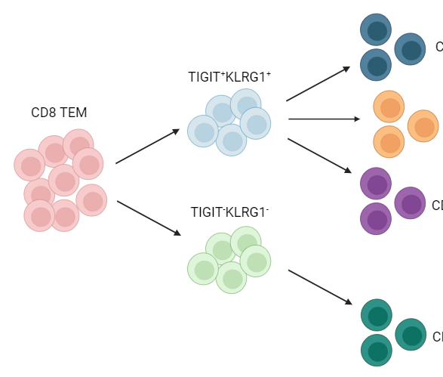
Study design
bulk ATAC-seq of 5 populations (bolded)
TIGIT⁺
KLRG1⁺ (DP)
DP CD57⁺
not-naive
CD8s
DP PD1⁺
AbATE (teplizumab) subjects
DP CD127⁺
TIGIT⁻KLRG1⁻ (DN)
non-exhausted (not DP) CD127⁺
6 responders, TIGIT⁺KLRG1⁺ high
sort
4 non-responders, TIGIT⁺KLRG1⁺ low
CyTOF
Notes:
KLRG1: co-inhibitory receptor belonging to inhibitory killer cell lectin-like receptors on NK cells and antigen-experienced human T cells, thought to be a senescent marker for human T cells with poor proliferation and impaired clonal expansion after stimulation
CD127 = IL7R
Motivation for point 2:
PD-1+ associated with better outcome
CD127+ associated with worse outcome
Point #1: i.e. are some more Tex?
T1DAL: alefacept (LFA3-Ig fusion, binds CD2, disrupts CD58-mediated costimulation of T cells, selectively depletes memory/effector T cells)
CD2 costimulation can prevent exhaustion, alefacept (anti-CD2) can help treat T1D i.e. by allowing exhaustion presumably
Teplizumab: humanized anti-CD3 monoclonal Ab to delay onset of stage 3 T1D in people with stage 2 T1D. mechanism: weak agonist of TCR-CD3 to induce anergy/apoptosis of T cells (i.e. autoreactive Teffs I presume)
Epigenetic analysis of PD-1⁺ Tex subset may inform clinical trial design with PD-1 agonism
10 samples from anti-CD3 (AbATE) treated T1D, peak of response
Estimated cell yields (30K sorted cells for bulk ATAC)
Responder = <40% decline in C-peptide AUC in two years
Teplizumab: humanized anti-CD3 monoclonal Ab to delay onset of stage 3 T1D in people with stage 2 T1D. mechanism: weak agonist of TCR-CD3 to induce anergy/apoptosis of T cells (i.e. autoreactive Teffs I presume)
Also took cells for CyTOF (Tex markers and Teff, I’m not sure of results from this though…)
Blocking IL7R seems to protect against T1D, so CD127+ is associated with worse T1D prognosis

Slide 8
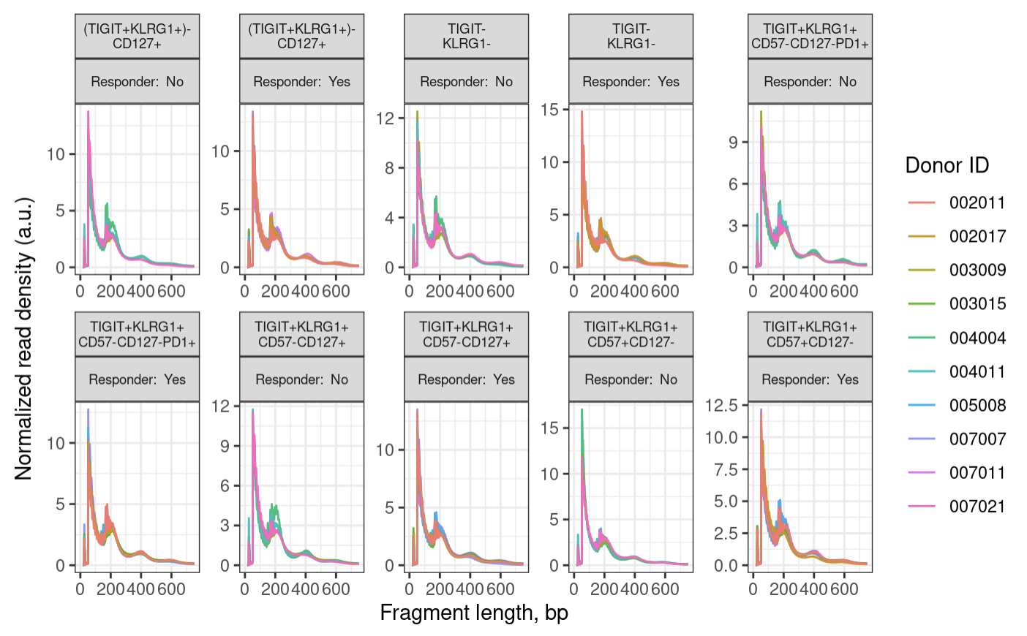
Fragment size distributions pass QC
Non-exhausted CD127⁺
Non-exhausted CD127⁺
DN
DN
DP PD-1⁺
DP PD-1⁺
DP CD127⁺
DP CD127⁺
DP CD57⁺
DP CD57⁺
Notes:
100 bp peak, 200, 400 bp oscillations
expect a peak around 100 bp (nuclesome free region) and then oscillations with maxima 200 bp mono-nucleosome, 400 bp di-nucleosome and so on
wiggles in the below plot are a biological feature and come from 10 bp per helical turn of the DNA
200 is like 2 100s together due to a nucleosome b/w preventing cut

Slide 9
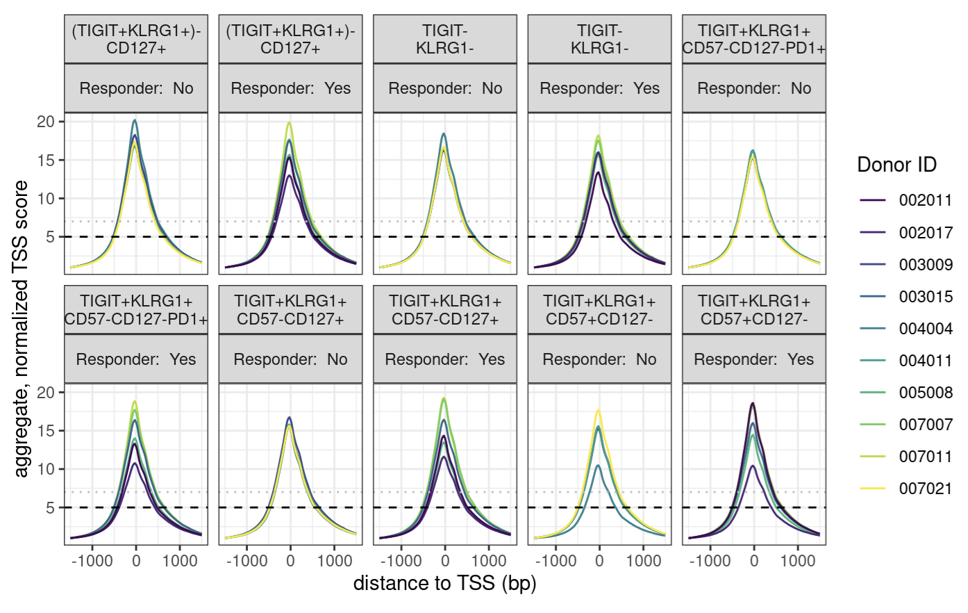
Enrichment over the TSS passes QC
Non-exhausted CD127⁺
Non-exhausted CD127⁺
DN
DN
DP PD-1⁺
DP PD-1⁺
DP CD127⁺
DP CD127⁺
DP CD57⁺
DP CD57⁺
Notes:
enrichment over TSS, signal:noise
we are looking for > 7, while 5-7 is still acceptable

Slide 10
After QC (all libraries pass)
Merge alignment .bam files by study group (cell sort + responder status)
Call peaks on merged alignment files
Merge peaks to obtain “consensus peaks” (candidate genomic regions with biological relevancy across samples & study groups)
Notes:
Merging alignment bams ~= pile up reads
Steps 1-2 ~ pseudobulking for RNA degs
Consensus = relevant across samples vs. just in 1/few samples
Consensus peaks = candidate regions (binned genome), we need them because we need to be looking at peaks that are relevant across samples vs. peaks just in 1/few samples?
*2-4 are an alternative to default of obtaining consensus peaks by fixed list of 400 bp wide peaks overlapping between > 2 samples (washes out signal)
This approach deals with different peak widths across samples better, obtaining more representative peaks, should be more sensitive
Is this kind of like pseudobulking?

Slide 11
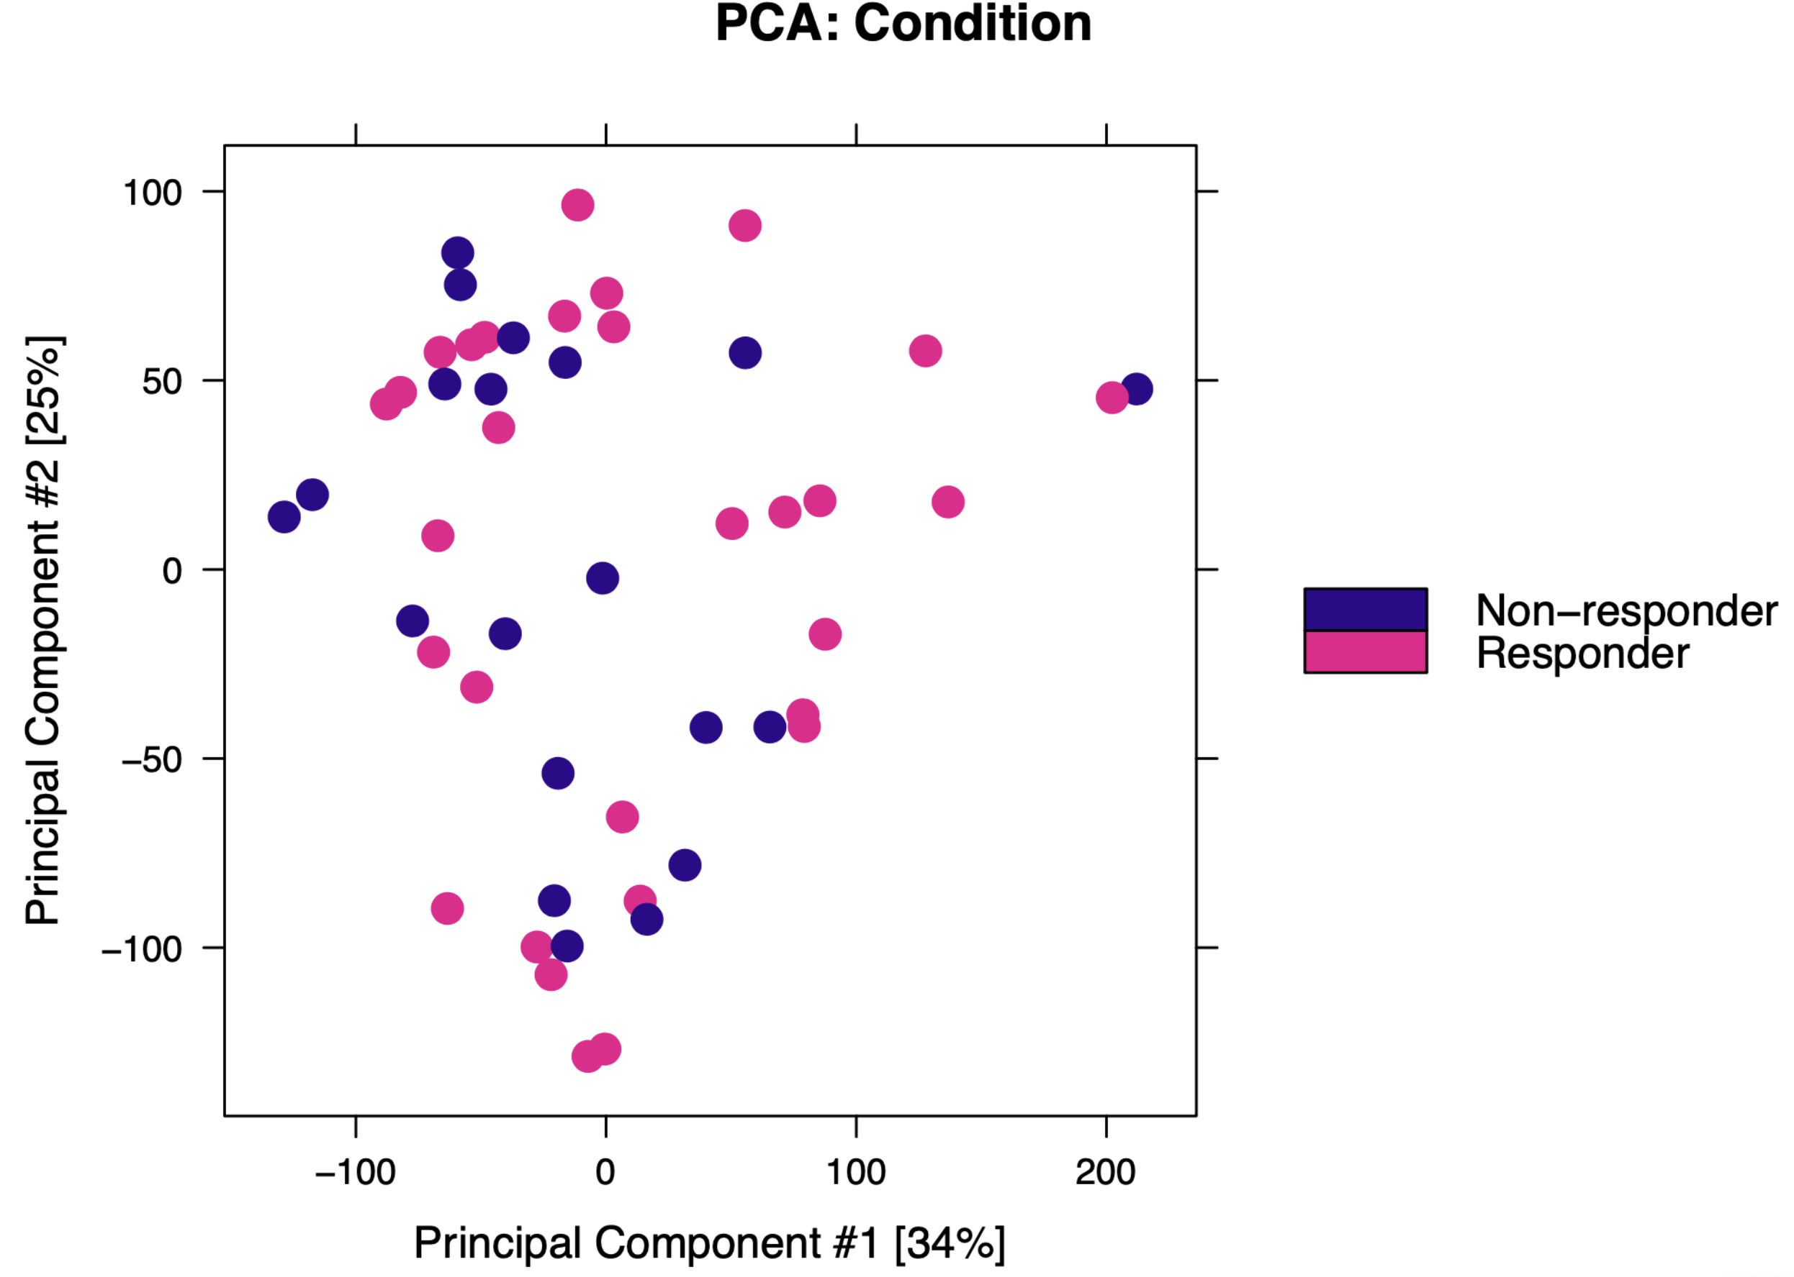
Epigenetic profiles between responders and non-responders are similar
R & NR grouped for all subsequent analyses

Slide 12
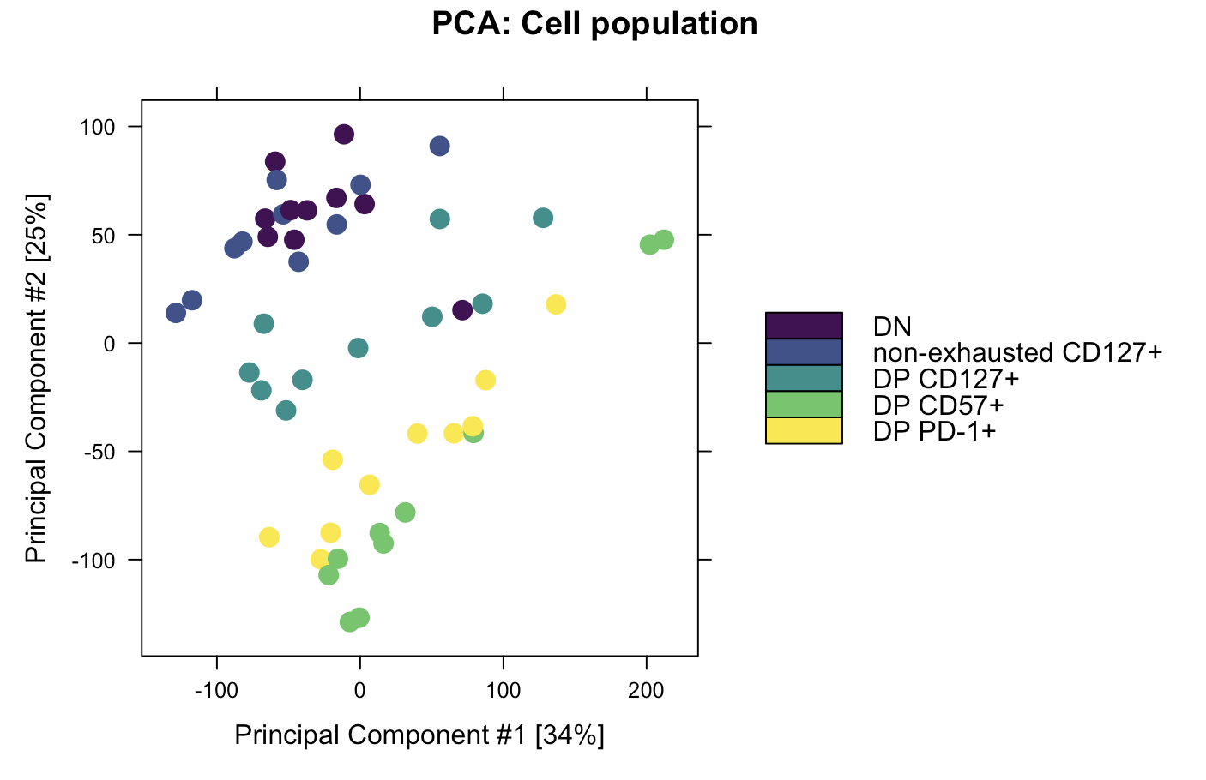
Epigenetic profiles of cell types differ

Slide 13
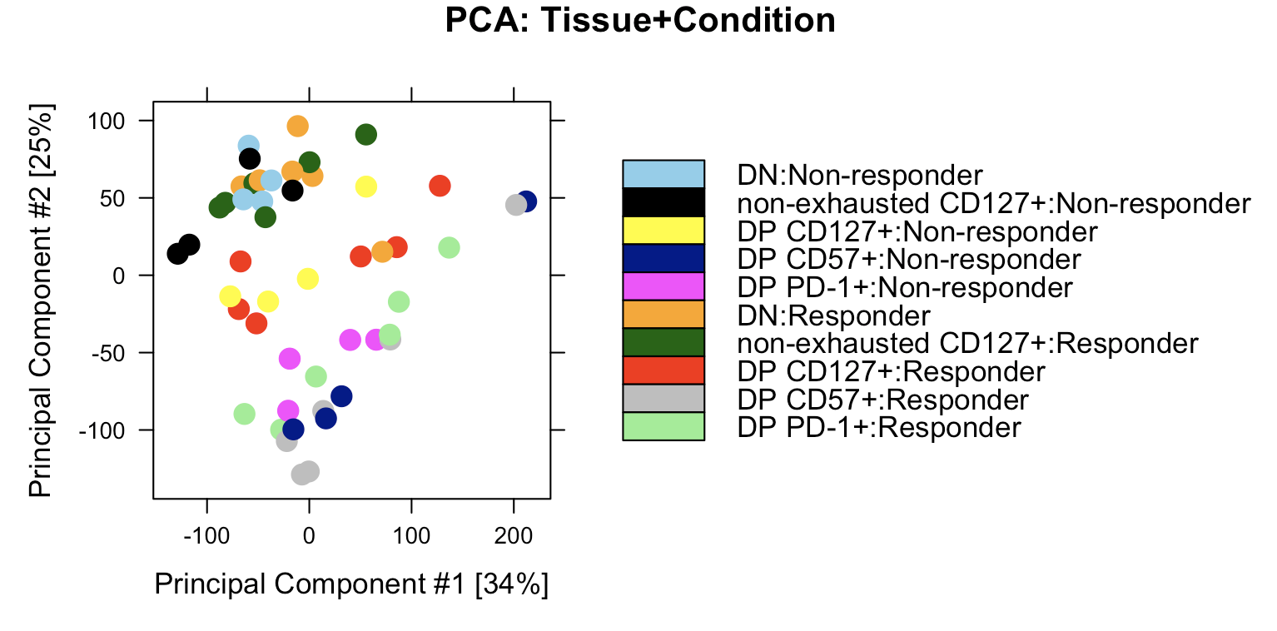
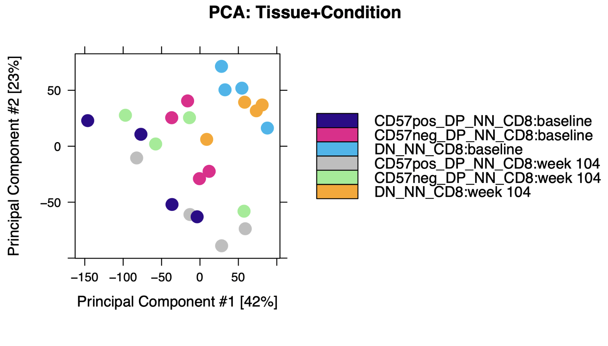
Donor to donor variability is comparable with P452 T1DAL analyses
DP CD57⁺:baseline
DP PD-1⁺: baseline
DN: baseline
DP CD57⁺: week 104
DP PD-1⁺: week 104
DN: week 104
P576
P452

Slide 14
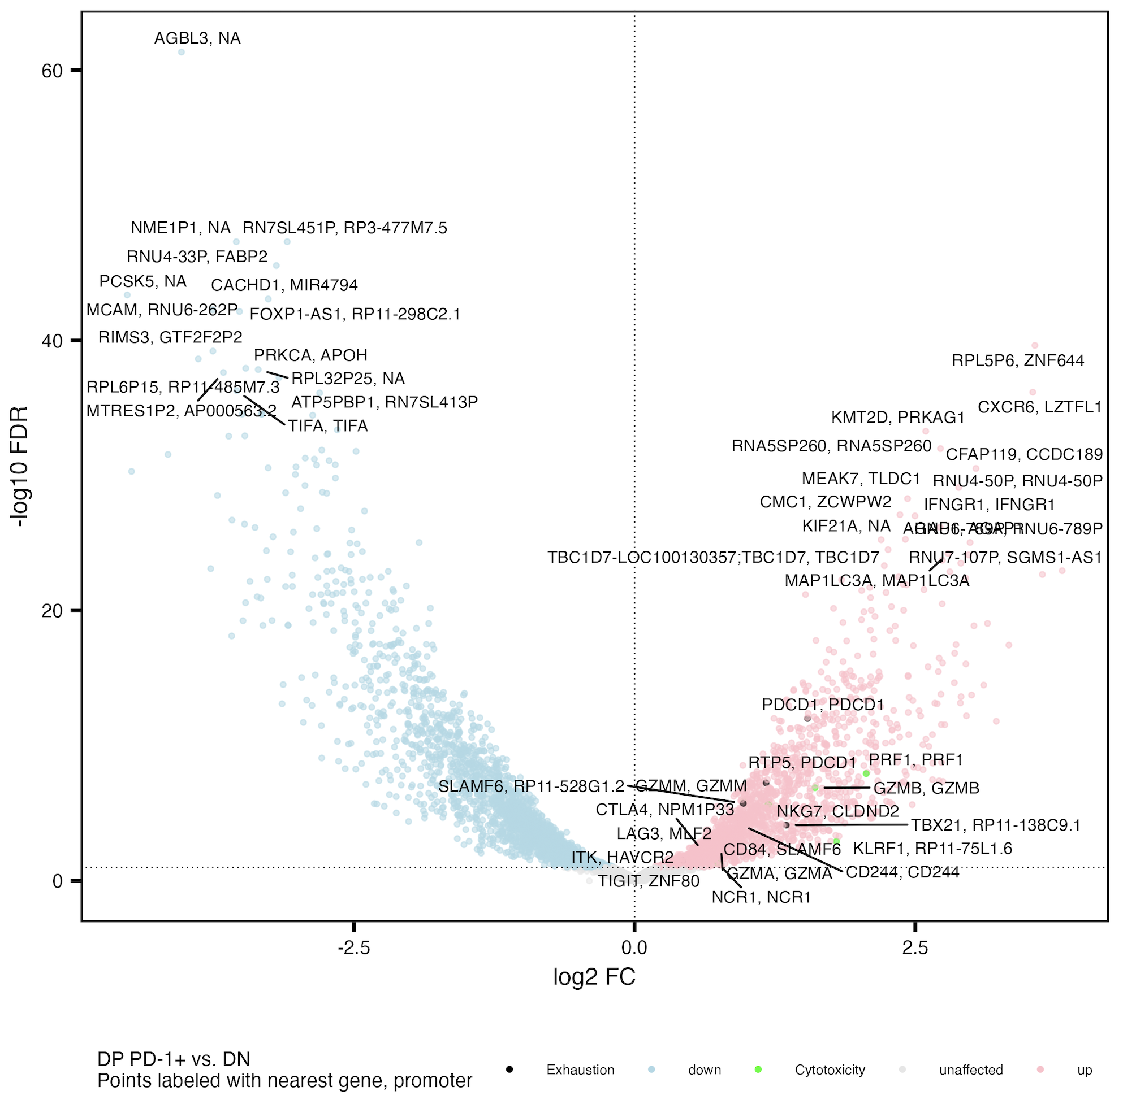
Cytotoxicity and exhaustion genes more accessible in DP PD-1⁺ vs. DN
Similar to Erin’s P452 T1DAL analyses
Exhaustion: CD244, SLAMF6, TBX21, PDCD1, HAVCR2, KLRG1, TOX, TCF1, PD1, CTLA4, LAG3, TIM3, TIGIT, KIR3DL2, KIR2DL3, NKG2A
Cytotoxicity: GZMA, GZMB, GZMH, GZMM, GZMK, PRF1, NCR1, KLRF1, NKG7
Notes:
Erin’s PD-1 up vs. DN: GZMB, GZMH, LAG3, TBX21, NKG7, CD244, KLRF1
Cytotoxicity up even though “exhausted” because DP is only partially exhausted? And DN can have other exhaustion markers I suppose

Slide 15
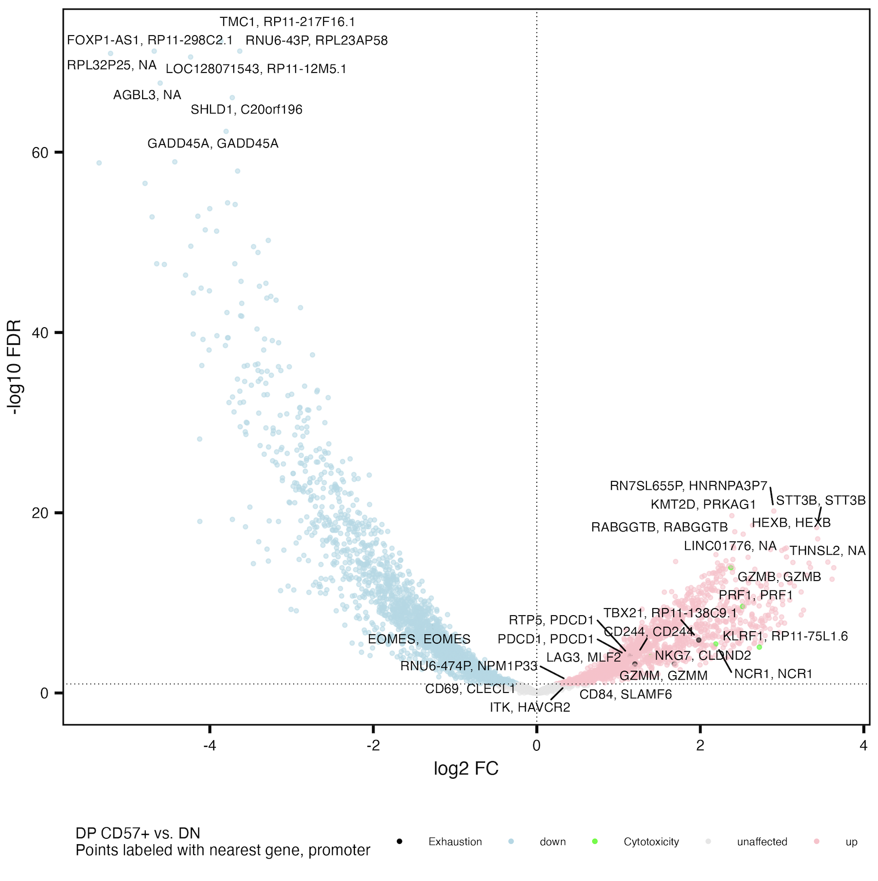
Cytotoxicity and exhaustion genes generally more accessible in DP CD57⁺ vs. DN
Similar to Erin’s P452 T1DAL analyses
Exhaustion: CD244, SLAMF6, TBX21, PDCD1, HAVCR2, KLRG1, TOX, TCF1, PD1, CTLA4, LAG3, TIM3, TIGIT, KIR3DL2, KIR2DL3, NKG2A
Cytotoxicity: GZMA, GZMB, GZMH, GZMM, GZMK, PRF1, NCR1, KLRF1, NKG7
Notes:
Erin’s CD57 up vs. DN: GZMB/GZMH, NCR1, KLRF1, CD244, SLAMF6, LAG3, TBX21, PDCD1

Slide 16
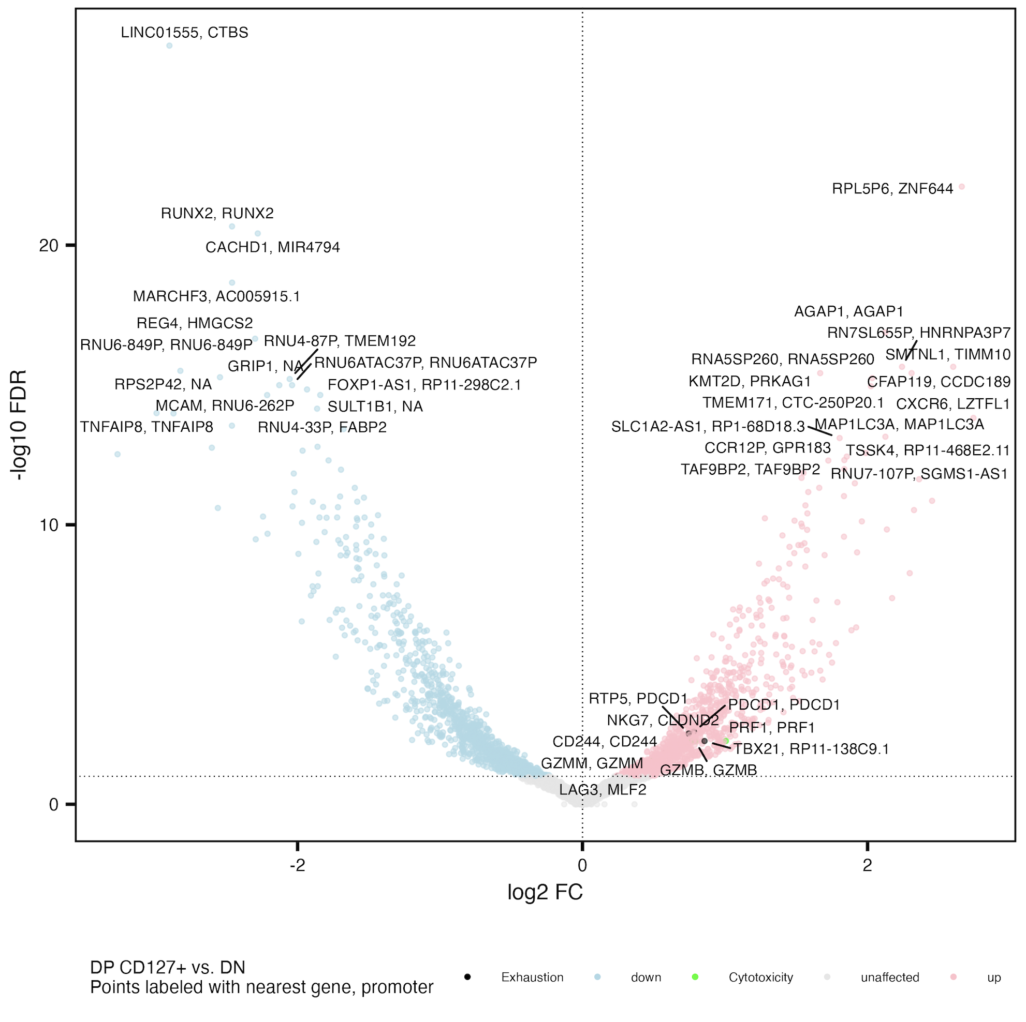
Cytotoxicity and exhaustion genes more accessible in DP CD127⁺ vs. DN
Exhaustion: CD244, SLAMF6, TBX21, PDCD1, HAVCR2, KLRG1, TOX, TCF1, PD1, CTLA4, LAG3, TIM3, TIGIT, KIR3DL2, KIR2DL3, NKG2A
Cytotoxicity: GZMA, GZMB, GZMH, GZMM, GZMK, PRF1, NCR1, KLRF1, NKG7

Slide 17
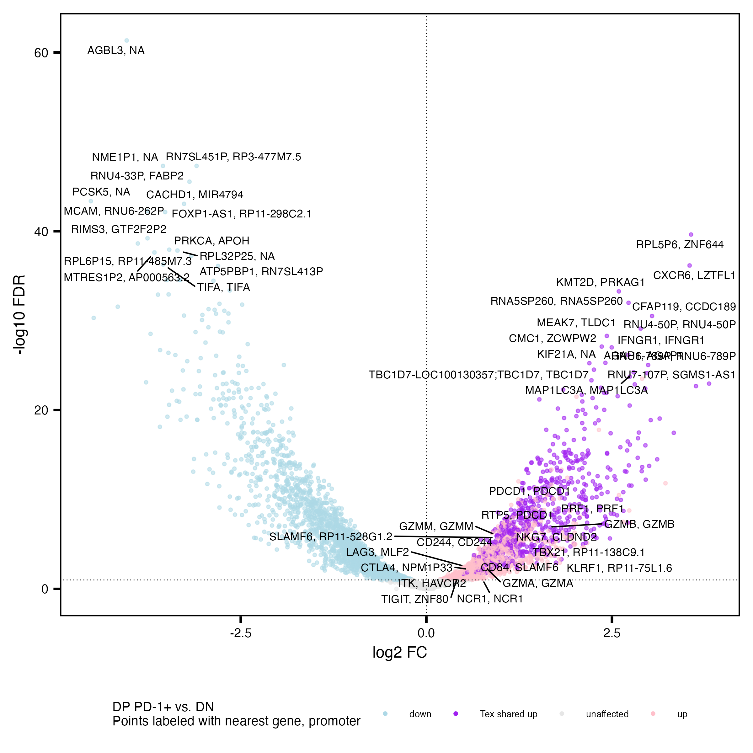
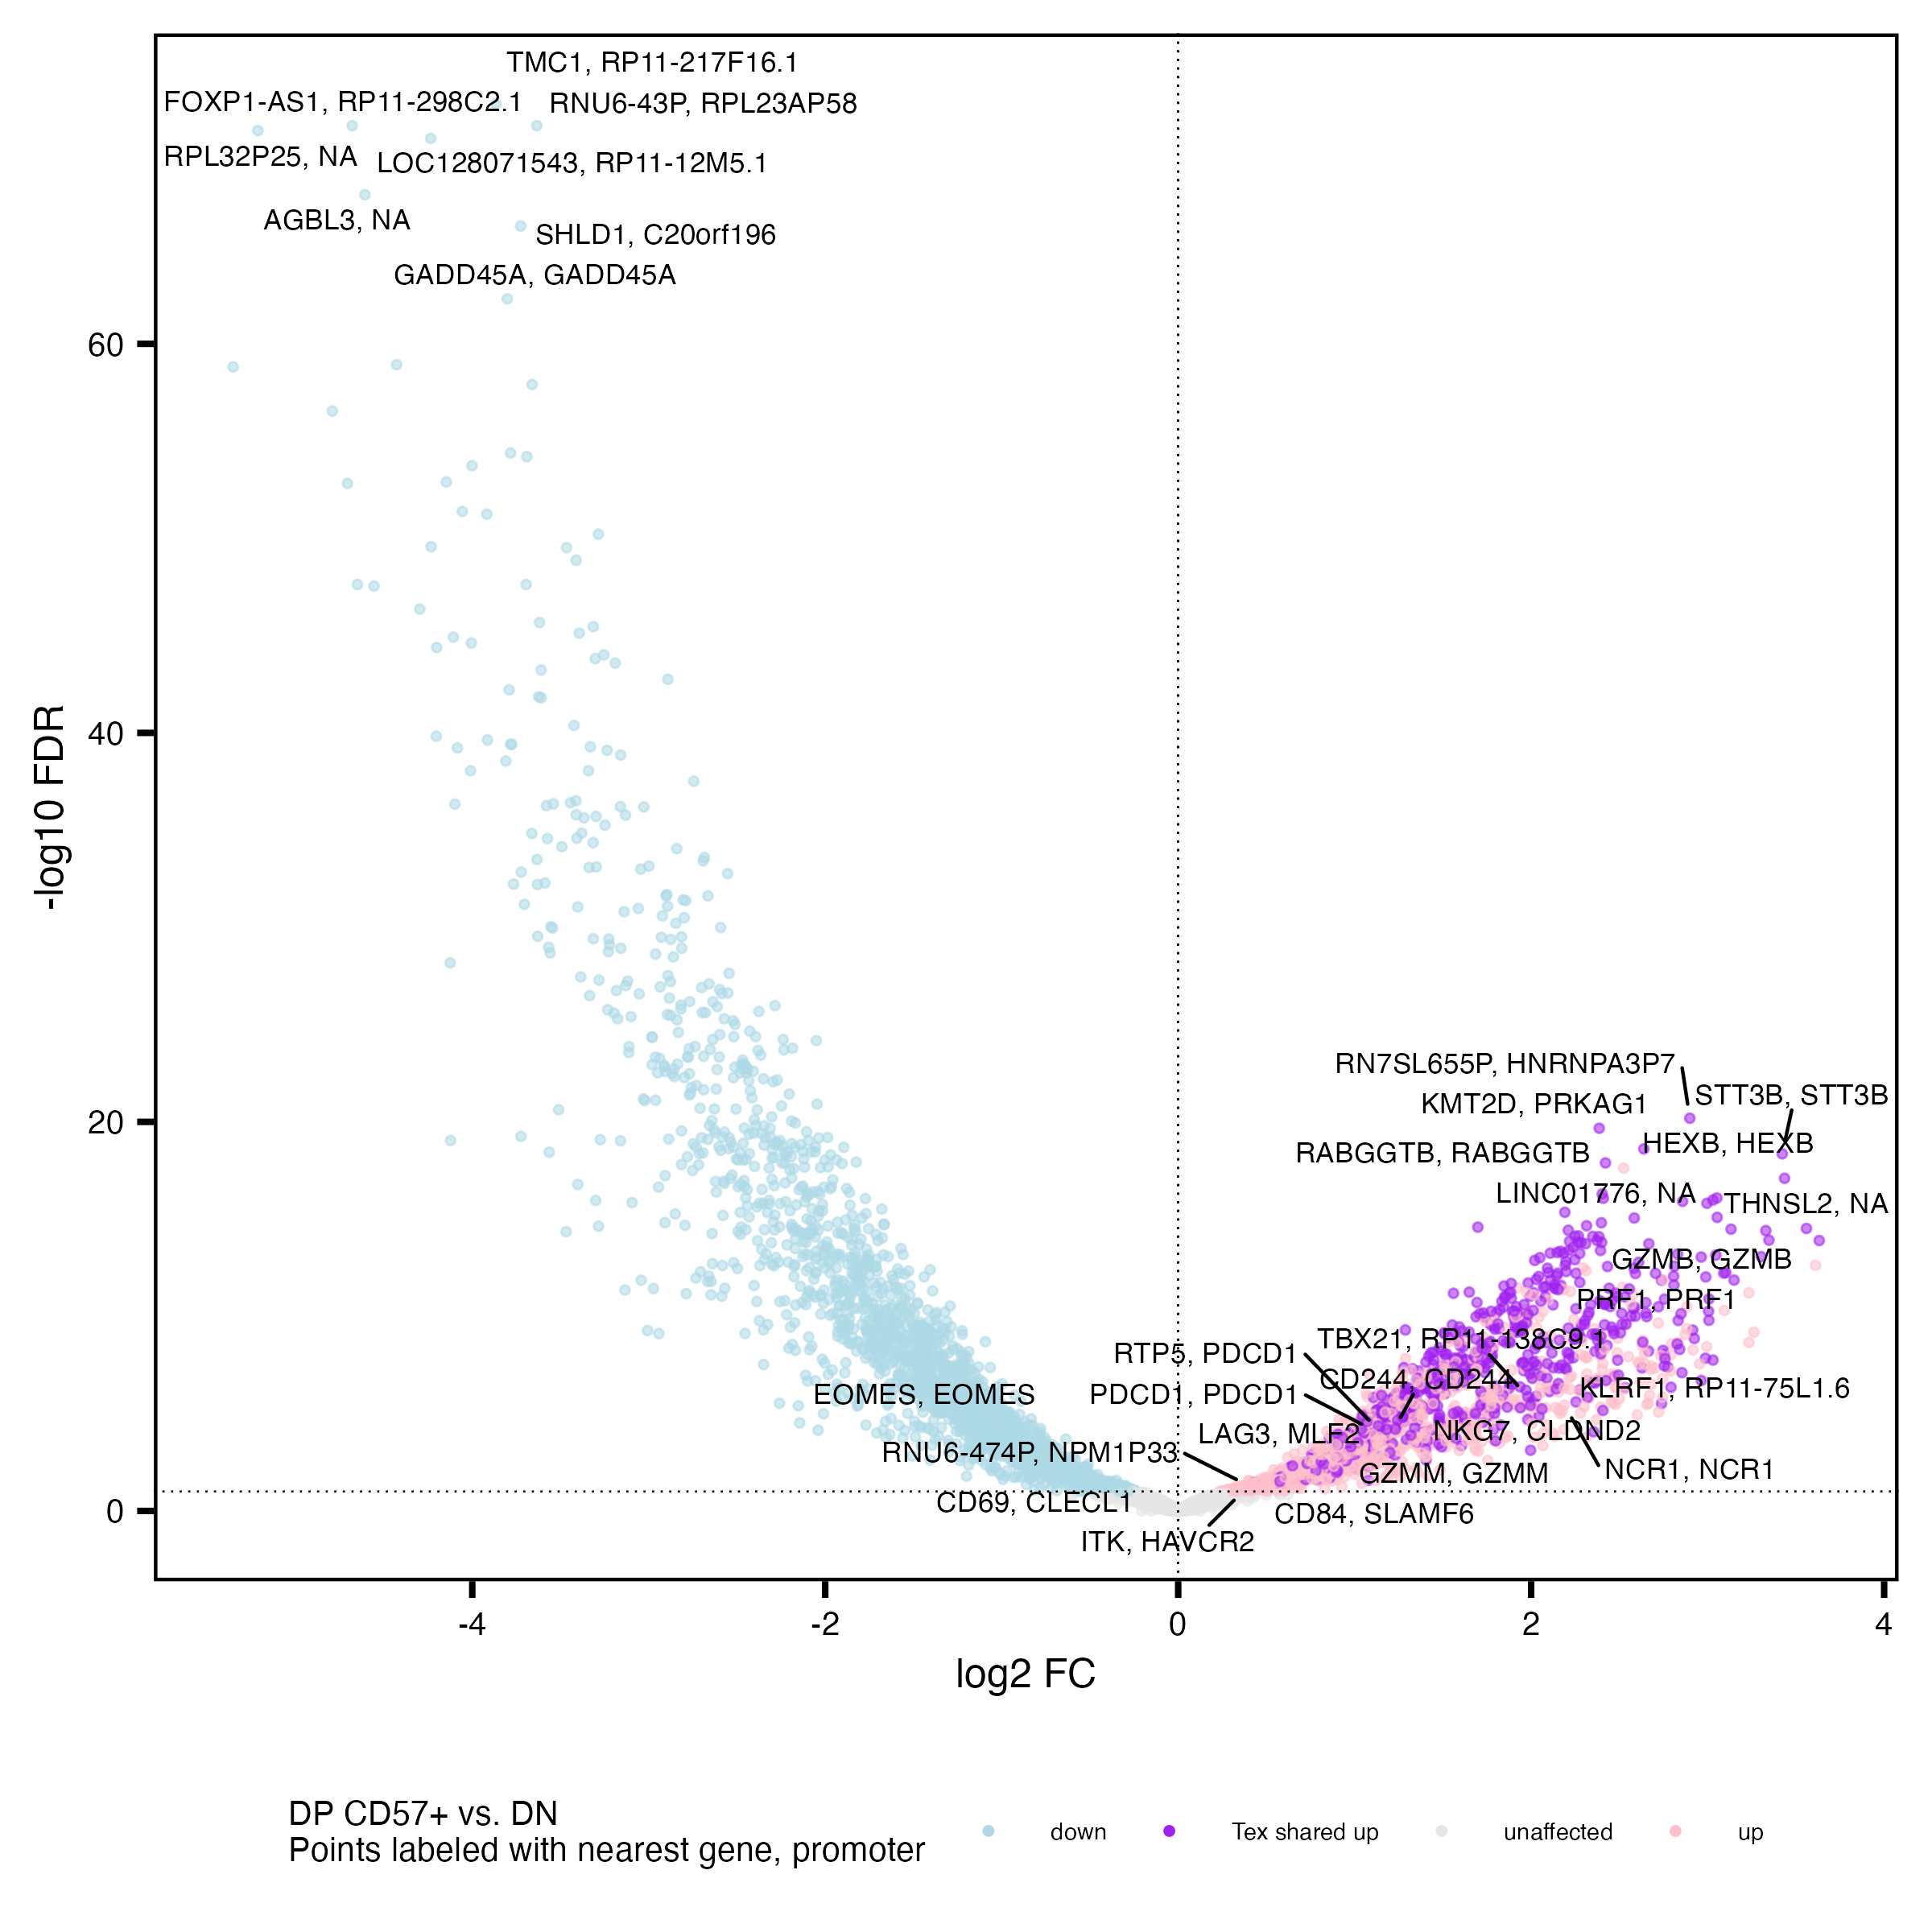
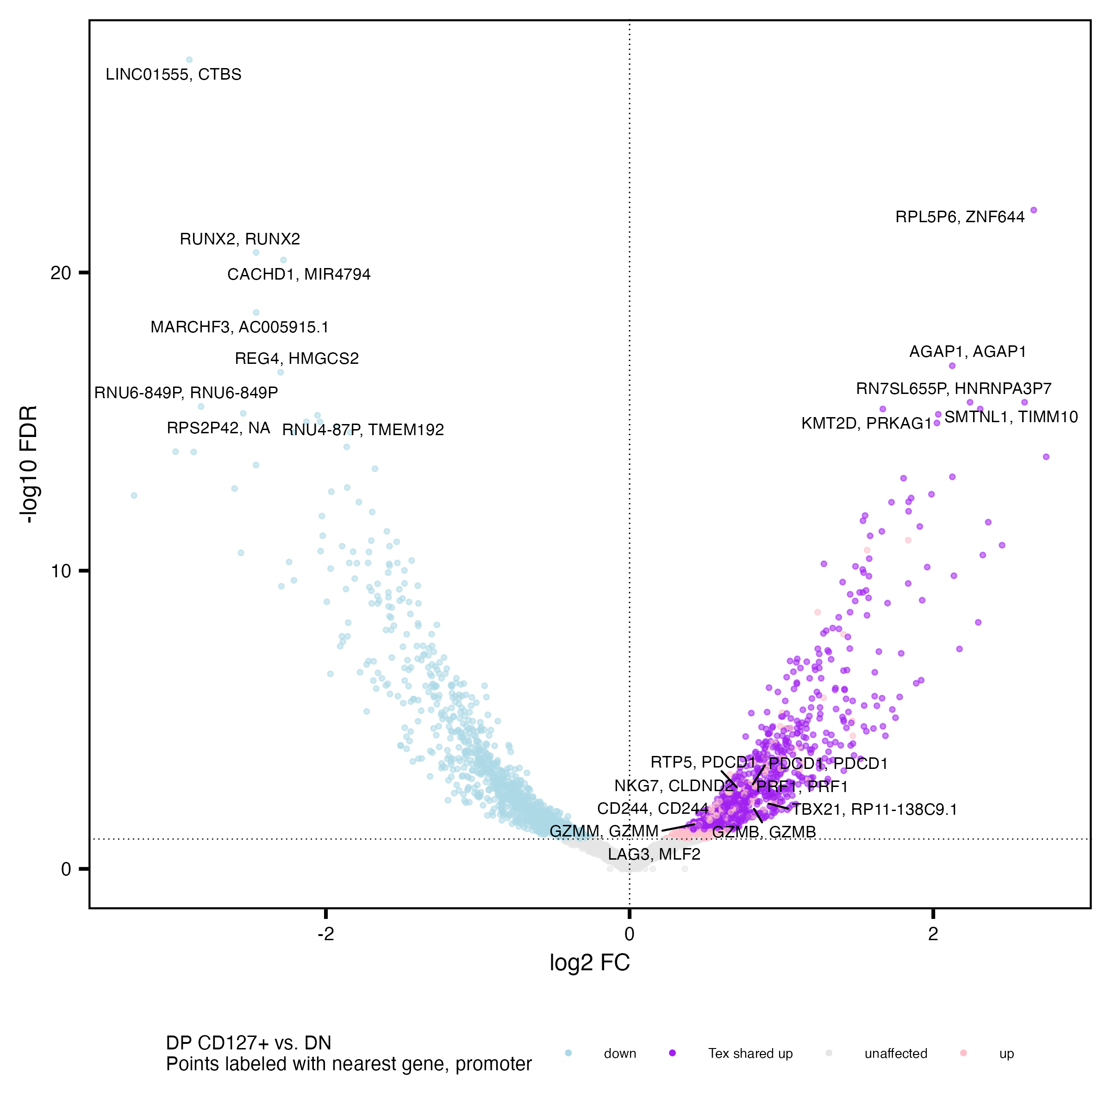
DP populations share many up vs. DN peaks’ closest genes with each other

Slide 18
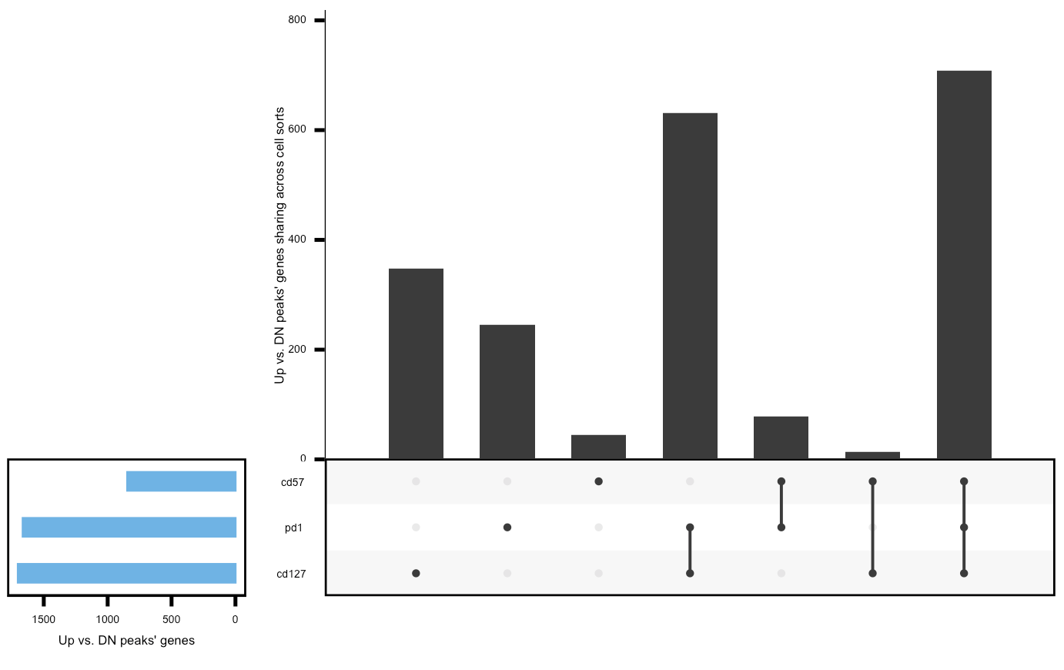
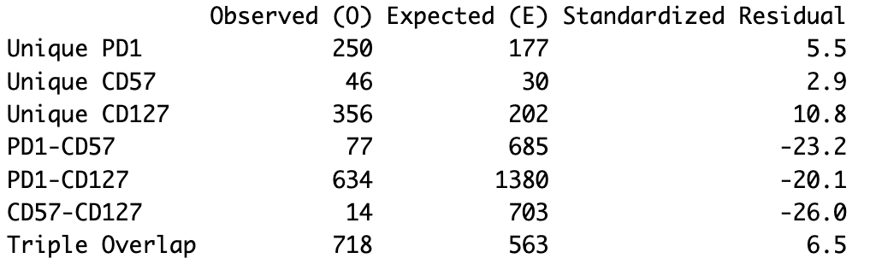
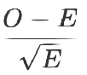
If a peaks’ gene is shared up in DP vs. DN, it’s likely shared among all 3 DPs (way fewer than expected double overlaps), DP CD127+ vs. DN most extreme in having more than expected unique up vs. DN peaks’ genes
Expected values from simulations
2,095 distinct up genes vs. DN across DPs
Observed values
Notes:
filtered for differentially accessible peaks with highest abs(FC) per gene (or promoter, similar results if using median)
then filtered for FC > 0 vs. DN
similar results if filtering for peaks < 5 kb from genes, looks similar for promoters
KIRs aren’t present in the unique to DP CD57⁺ fraction (not surprising, they don’t show up vs. DN, only vs. DP PD-1⁺)
5000 simulations

Slide 19
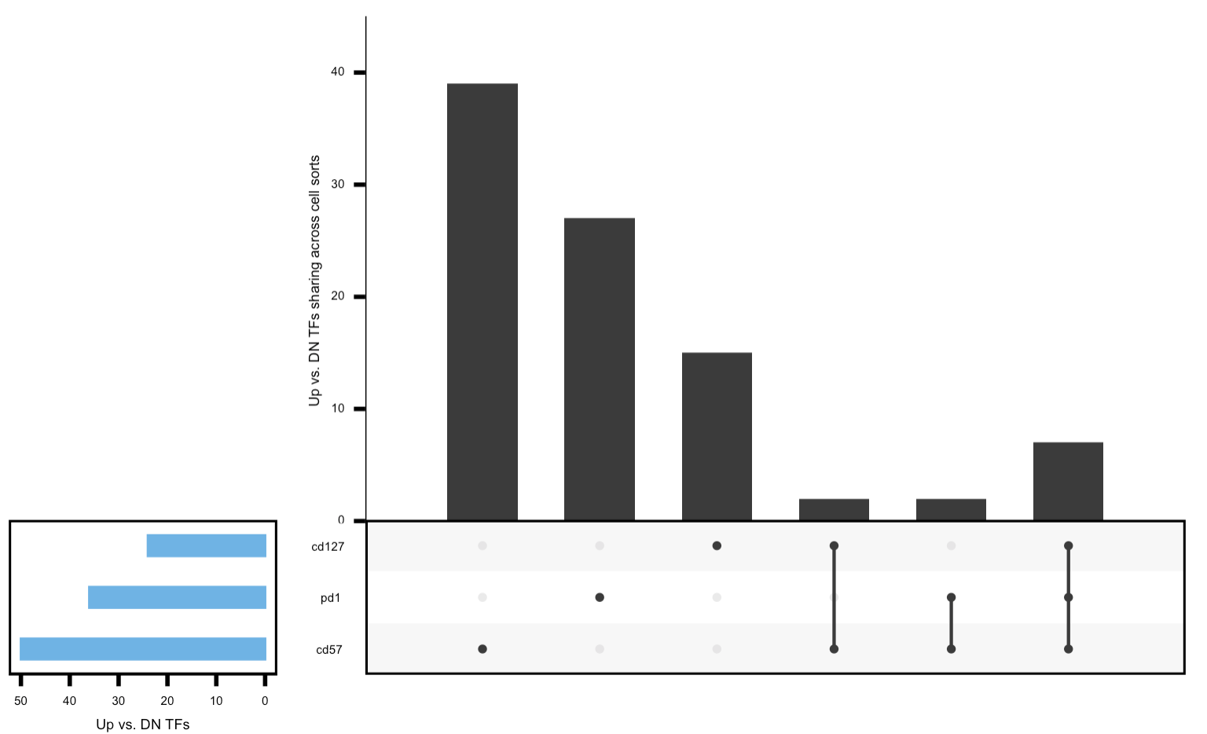
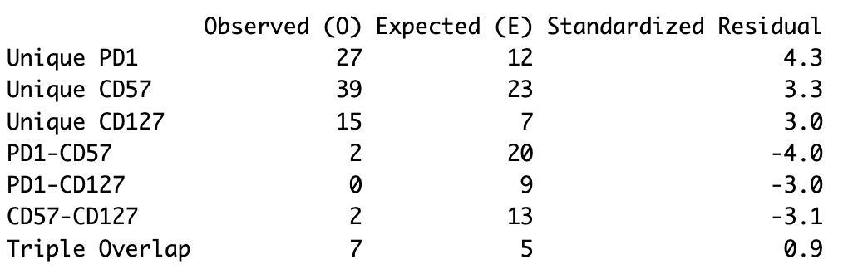
Again see less than expected double overlaps and more than expected uniques for TFs up in DPs vs. DN
Expected values from simulations
92 distinct up TFs vs. DN across DPs
Observed values

Slide 20
DP vs. DP Homer
Notes:
Generally similar to Erin’s analyses but some caveats (TCF7 up in PD-1+ vs. CD57+ strongest consistent hit)

Slide 21
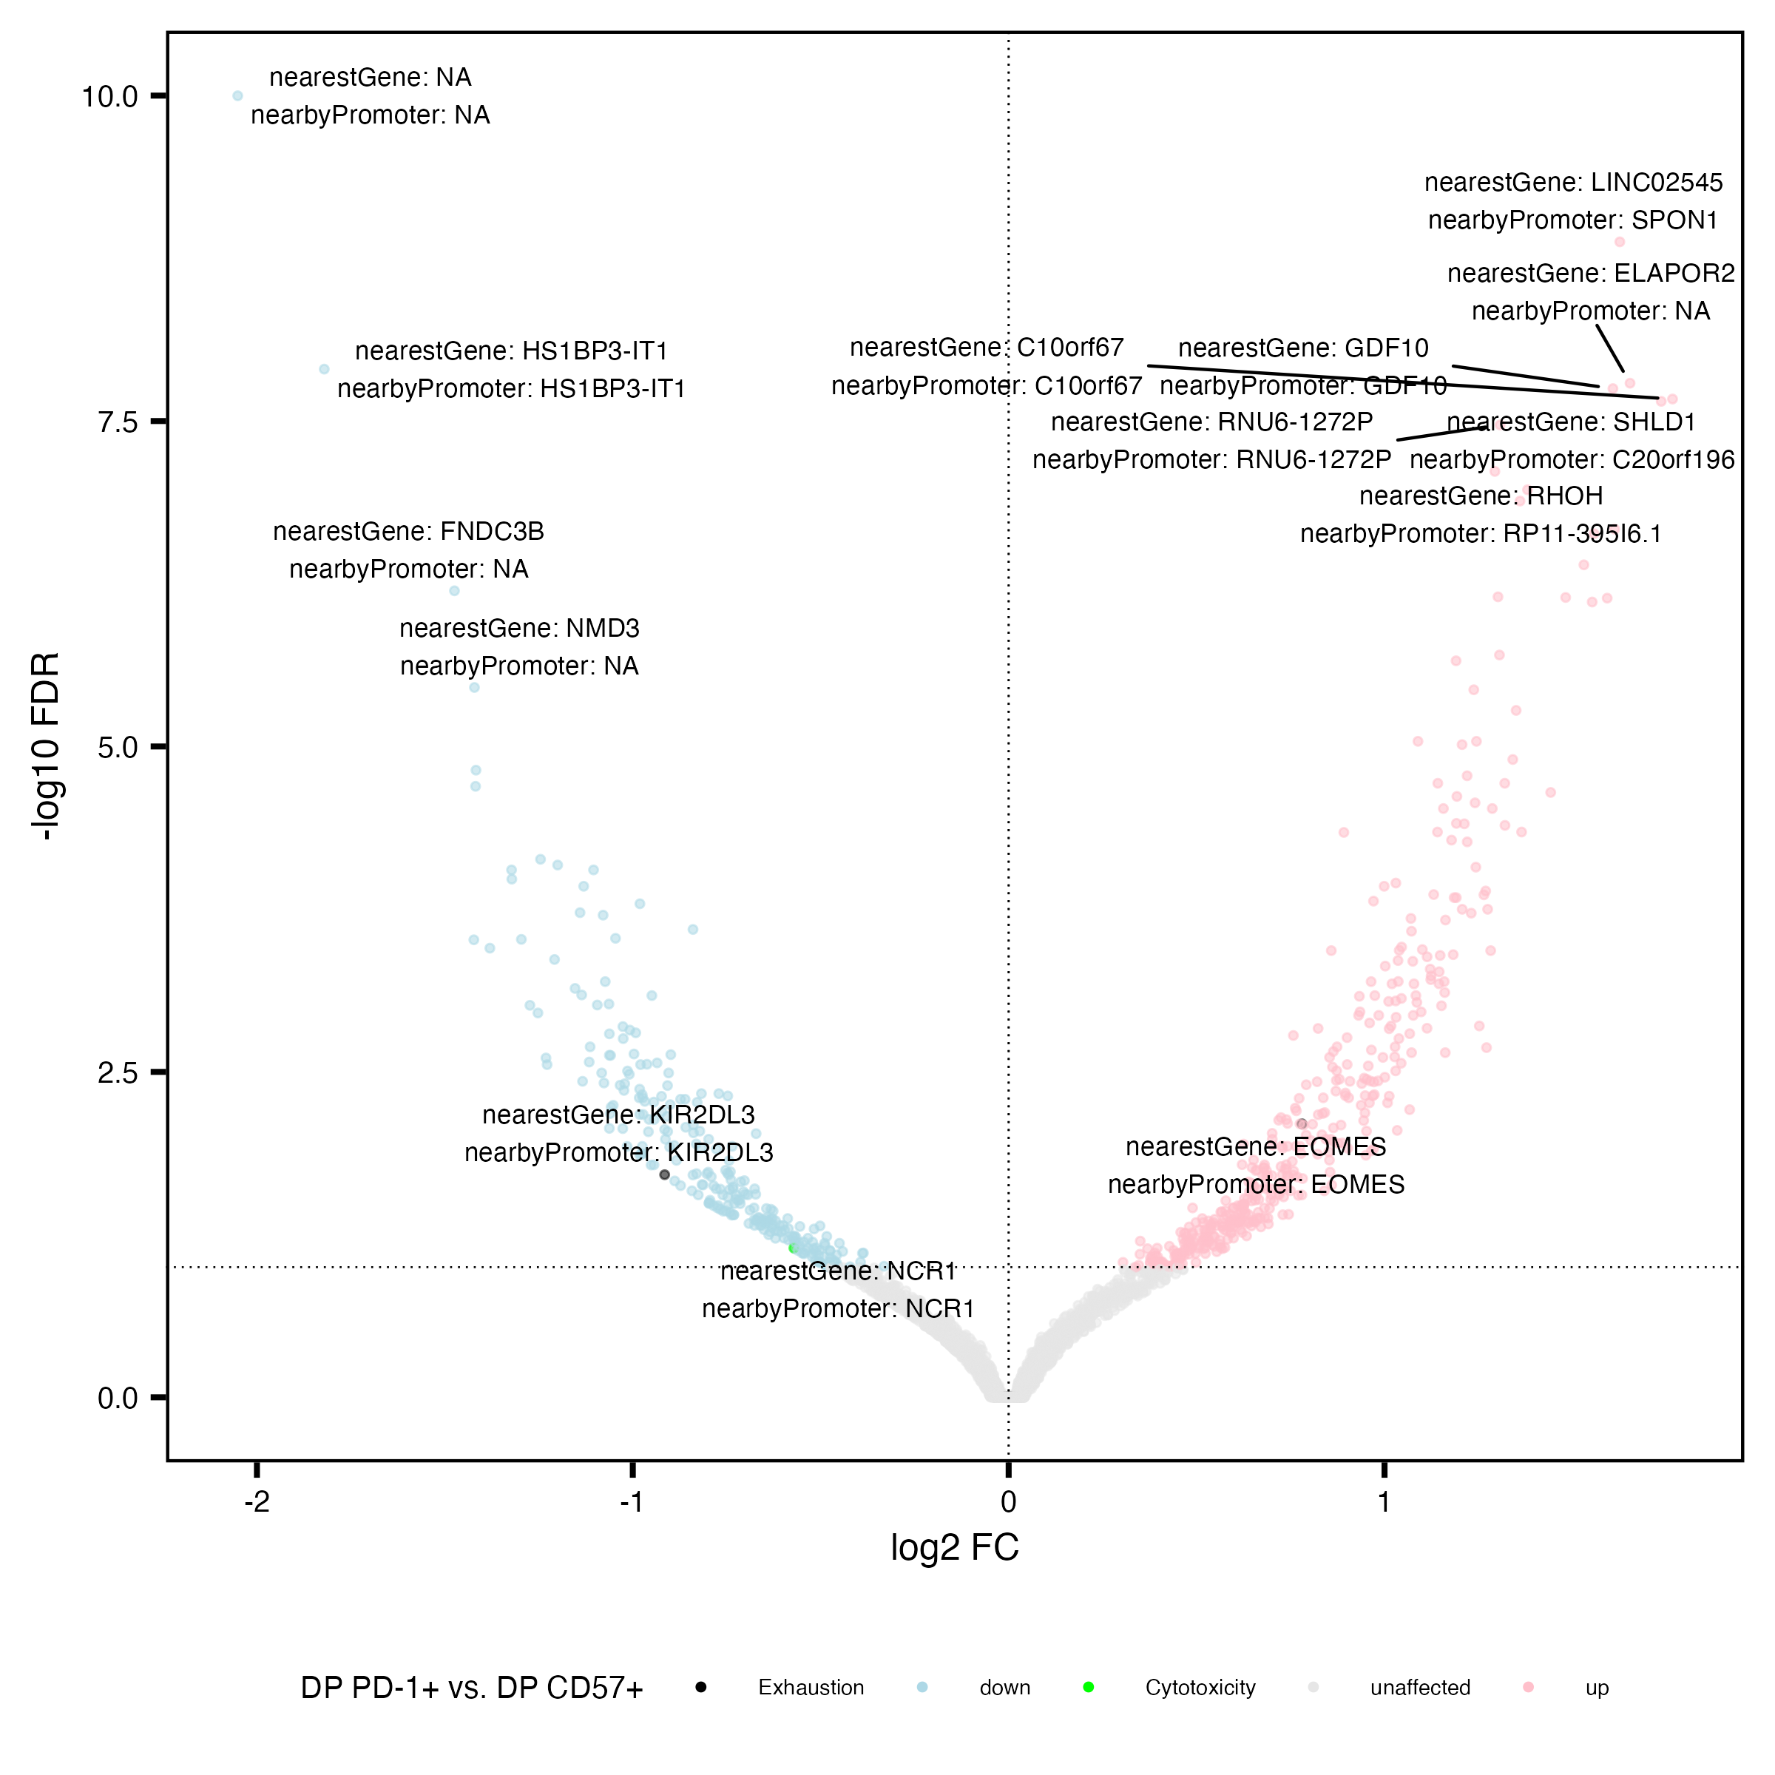
KIR2DL3 more accessible in DP CD57⁺ vs. DP PD-1⁺
Similar to Erin’s P452 T1DAL analyses
Exhaustion: CD244, SLAMF6, TBX21, PDCD1, HAVCR2, KLRG1, TOX, TCF1, PD1, CTLA4, LAG3, TIM3, TIGIT, KIR3DL2, KIR2DL3, NKG2A
Cytotoxicity: GZMA, GZMB, GZMH, GZMM, GZMK, PRF1, NCR1, KLRF1, NKG7

Slide 22
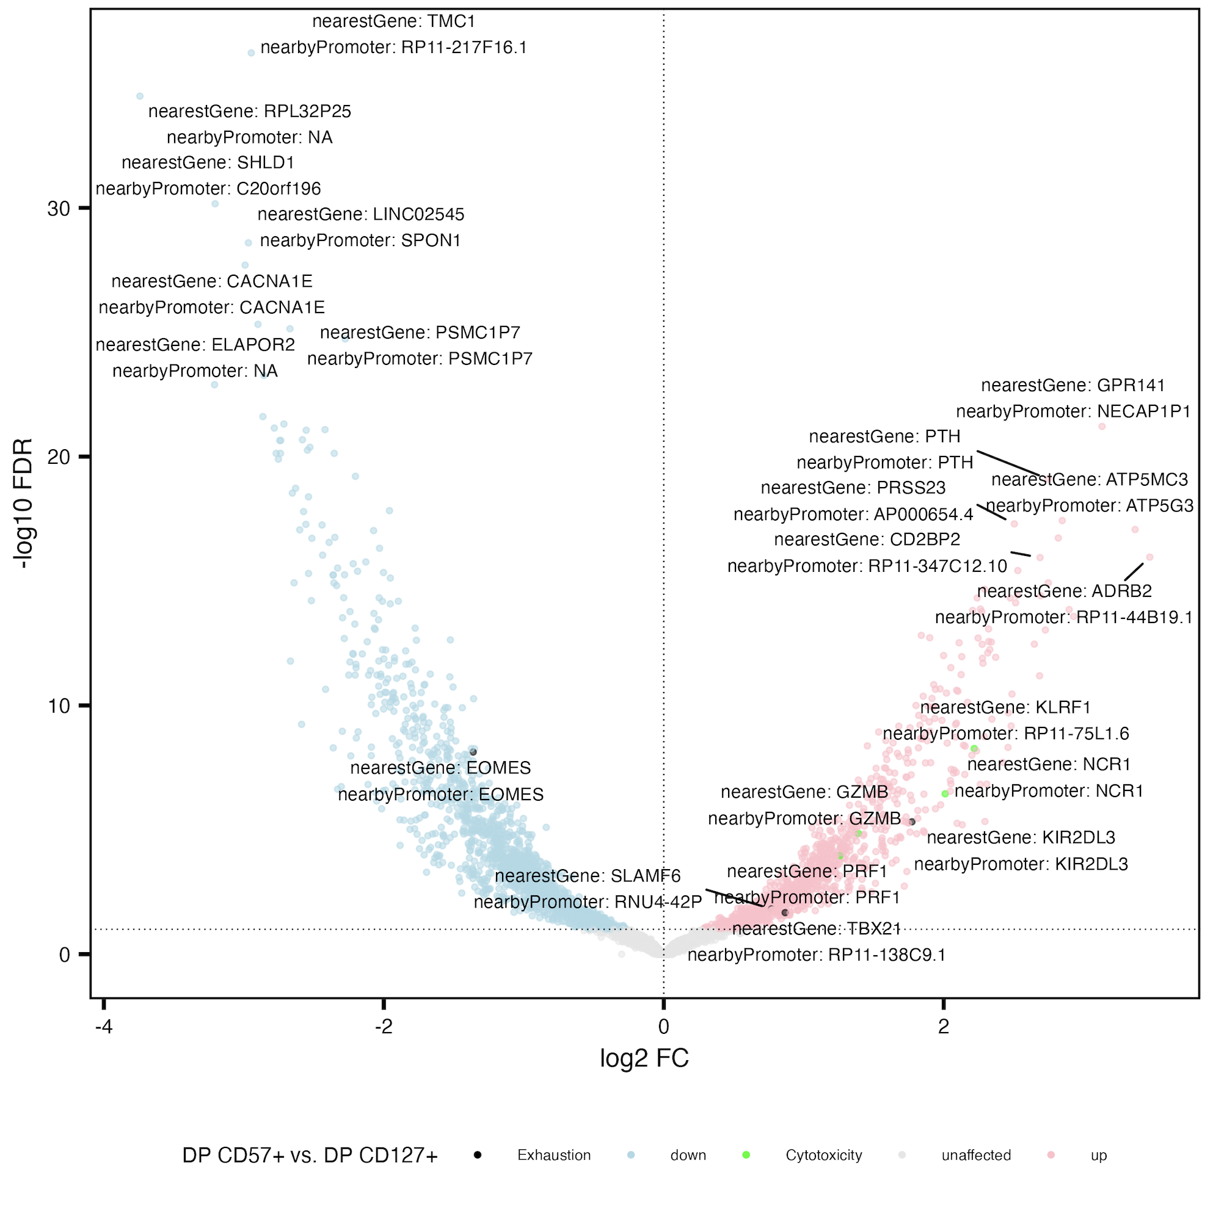
KIRs also more accessible in DP CD57⁺ vs. DP CD127⁺
Exhaustion: CD244, SLAMF6, TBX21, PDCD1, HAVCR2, KLRG1, TOX, TCF1, PD1, CTLA4, LAG3, TIM3, TIGIT, KIR3DL2, KIR2DL3, NKG2A
Cytotoxicity: GZMA, GZMB, GZMH, GZMM, GZMK, PRF1, NCR1, KLRF1, NKG7

Slide 23
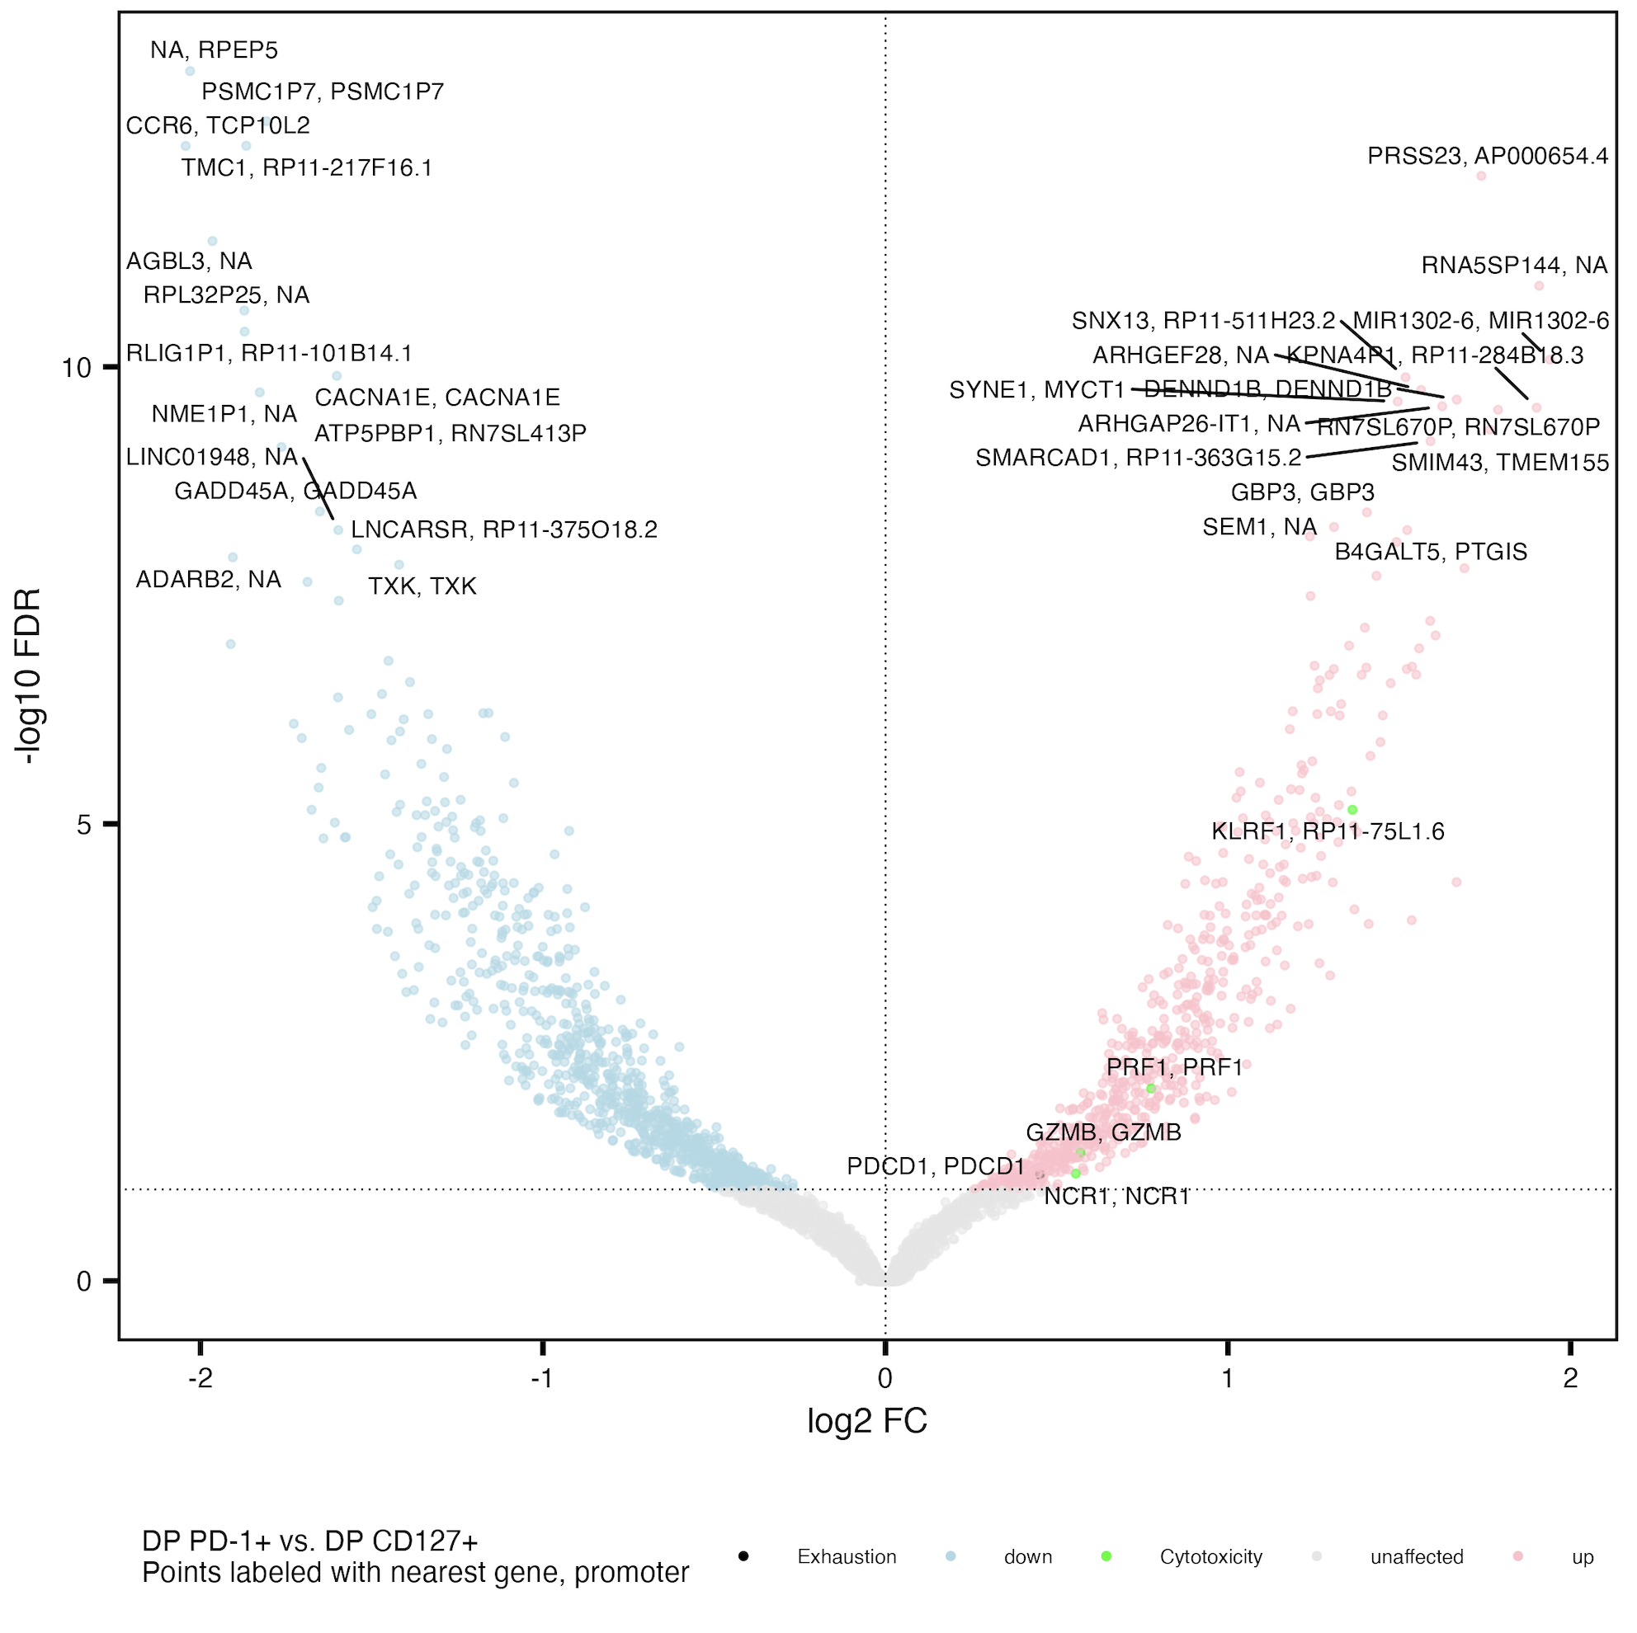
Cytotoxicity genes more accessible in DP PD-1⁺ vs. DP CD127⁺
Exhaustion: CD244, SLAMF6, TBX21, PDCD1, HAVCR2, KLRG1, TOX, TCF1, PD1, CTLA4, LAG3, TIM3, TIGIT, KIR3DL2, KIR2DL3, NKG2A
Cytotoxicity: GZMA, GZMB, GZMH, GZMM, GZMK, PRF1, NCR1, KLRF1, NKG7

Slide 24
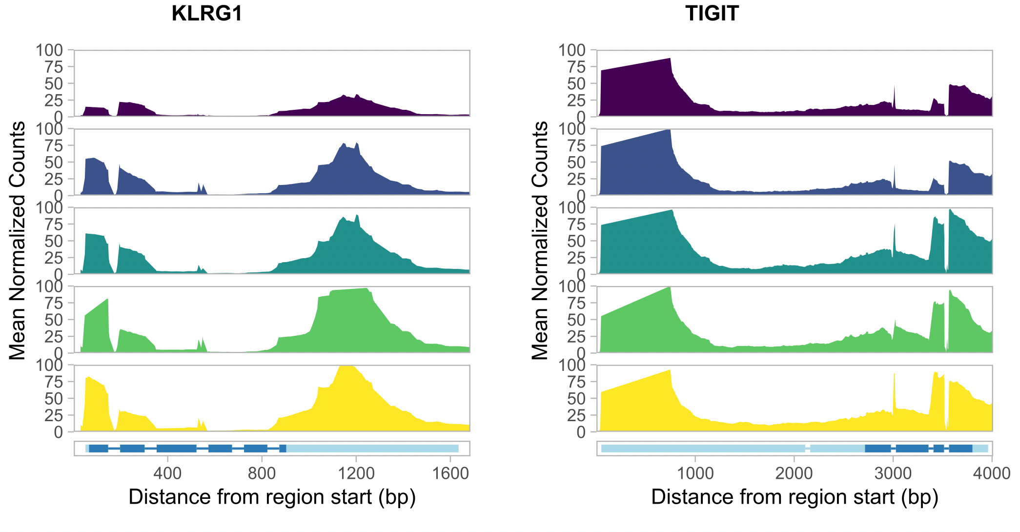
KLRG1 and TIGIT higher in DP cell populations
Also need to confirm w/ Stephan
That bigWigs weren’t already
Normalized for depth

Slide 25
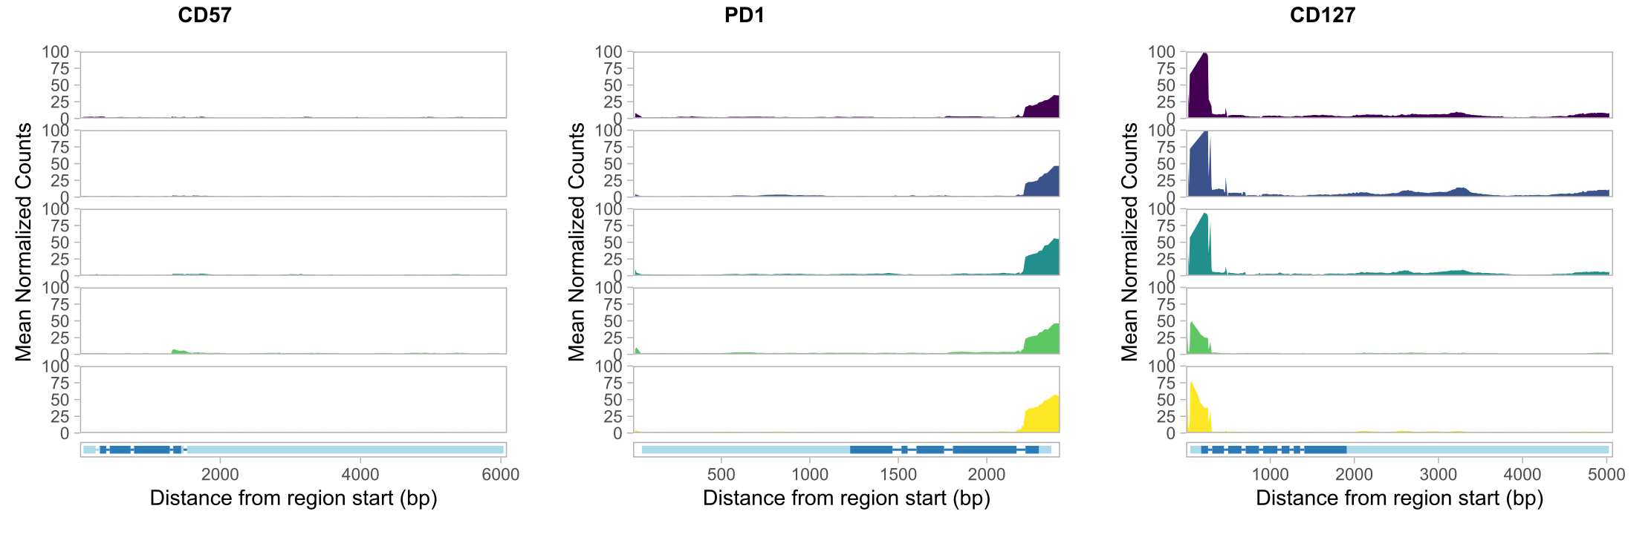
CD57, PD-1, and CD127 genes slightly more accessible in their sorted populations

Slide 26
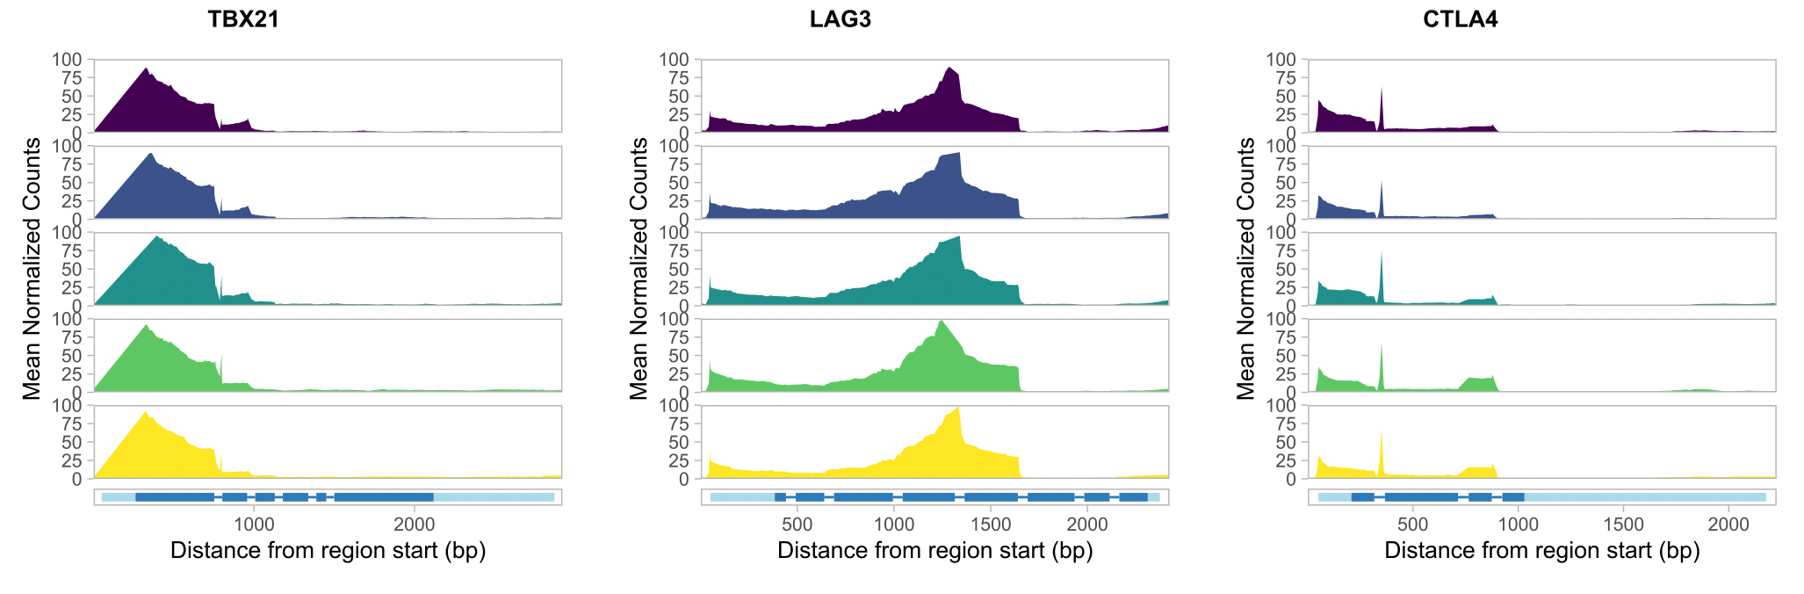
Exhaustion genes similarly accessible in cell populations

Slide 27
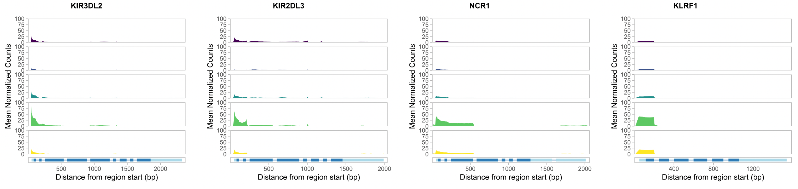
NCR1, KLRF1, and KIR genes more accessible in DP CD57⁺, as seen in Erin’s P452 analyses

Slide 28
Data I have but am not sure if/how to include…
PPIs: have a few in backup slides but not sure if worth including… DP vs. DN I think current VPs are sufficient, DP vs. DP maybe it’s interesting but not sure of any interpretations
KEGG enrichment: computationally not sure why I only get activated vs. down as well, also not really sure how helpful these are…

Slide 29
Analysis that would be great to do if possible
Heatmap of genes/promoters’ accessibilities by cell pop
Promoter code ready (Stephan heatmap code right after VPs), just need to update for genes
Then run on posit grouped design to be able to get across all cell pops

Slide 30
Conclusions
Responders and non-responders to teplizumab have similar epigenetic profiles in non-naïve CD8s
Different cell populations have different epigenetic profiles
Epigenetic profiles of DP PD-1⁺ and DP CD57⁺ appear similar between this and Erin’s P452 T1DAL projects

Slide 31
Discussion
Perhaps having TIGIT⁺KLRG1⁺ cell sort to compare to DP subpopulations would be beneficial for differentiation path model testing, not sure if we can distinguish between differentiation path models with this data…
Make new biorender model that’s more complex and may actually fit with data… (I guess evidence against 3 DP split at same time is that you’d expect more PD-1/CD57 similarity based on Erin’s TCR sharing stuff..) i.e. lots of triple DP vs. DN sharing but not really any double… i.e. that means if a peaks’ gene is shared up vs. DN it’s either unique or shared among all DP
DP CD127+ intermediate between DN/not DP CD127+ and PD1+/CD57+ (PD1+ being closer to CD127+ than CD57+)
Peaks’ genes (similar for promoters/peaks too): more triple sharing w/ DP vs. DN than expected, much lower double overlap than expected, more unique than expected
For Homer, more uniques and less doubles also seen
CD57+ up in KIRs relative to both other DPs
KLRG1 higher than CD127’s in PD1/CD57
CD57 lowest in CD127 sort, then PD1 sort, then same in other 3 sorts

Slide 32
Next steps
Infer meaning from KEGG enrichment analyses
PPIs also from peaks’ closest promoters
Make heatmaps of genes’/promoters’ accessibility by cell population
Investigate variability between donors in mean coverage plots and Homer analyses
P452 data: compare Homer results pre/post- downsampling read counts to levels similar to those here in P576 (i.e. is it worth $ to sequence P576 to greater depth)

Slide 33

Acknowledgements
Peter Linsley
Long lab
Alice Long
Alice Wiedeman
Josh Centore
Bioinformatics group
Erin Witkop
Stephan Pribitzer
Basilin Benson

Slide 34
Extra slides

Slide 35
DP T_{ex} populations are heterogeneous, overlapping
Notes:
CyTOF data I think

Slide 36
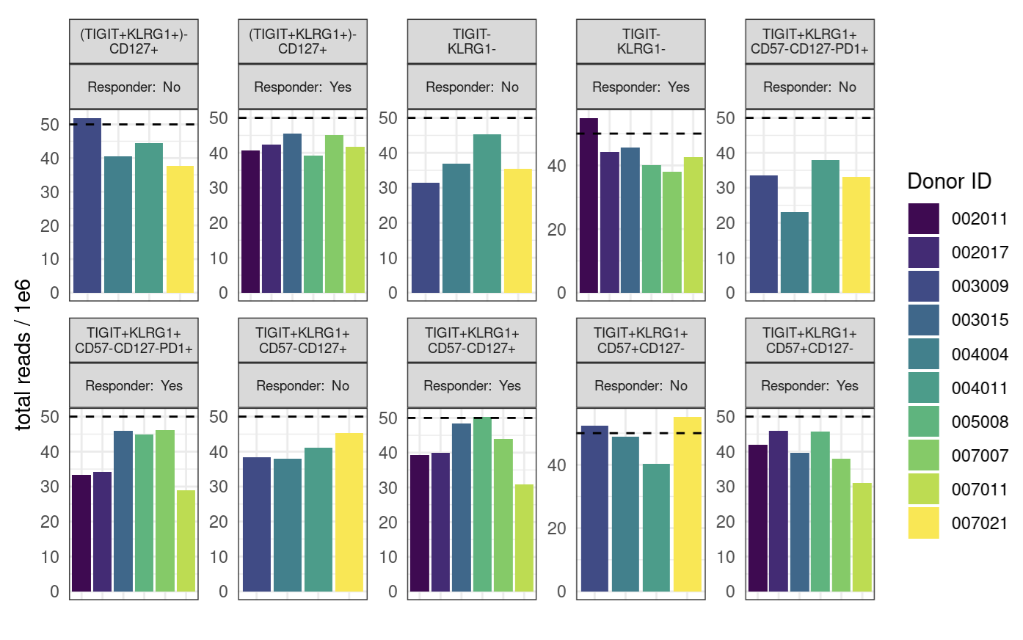
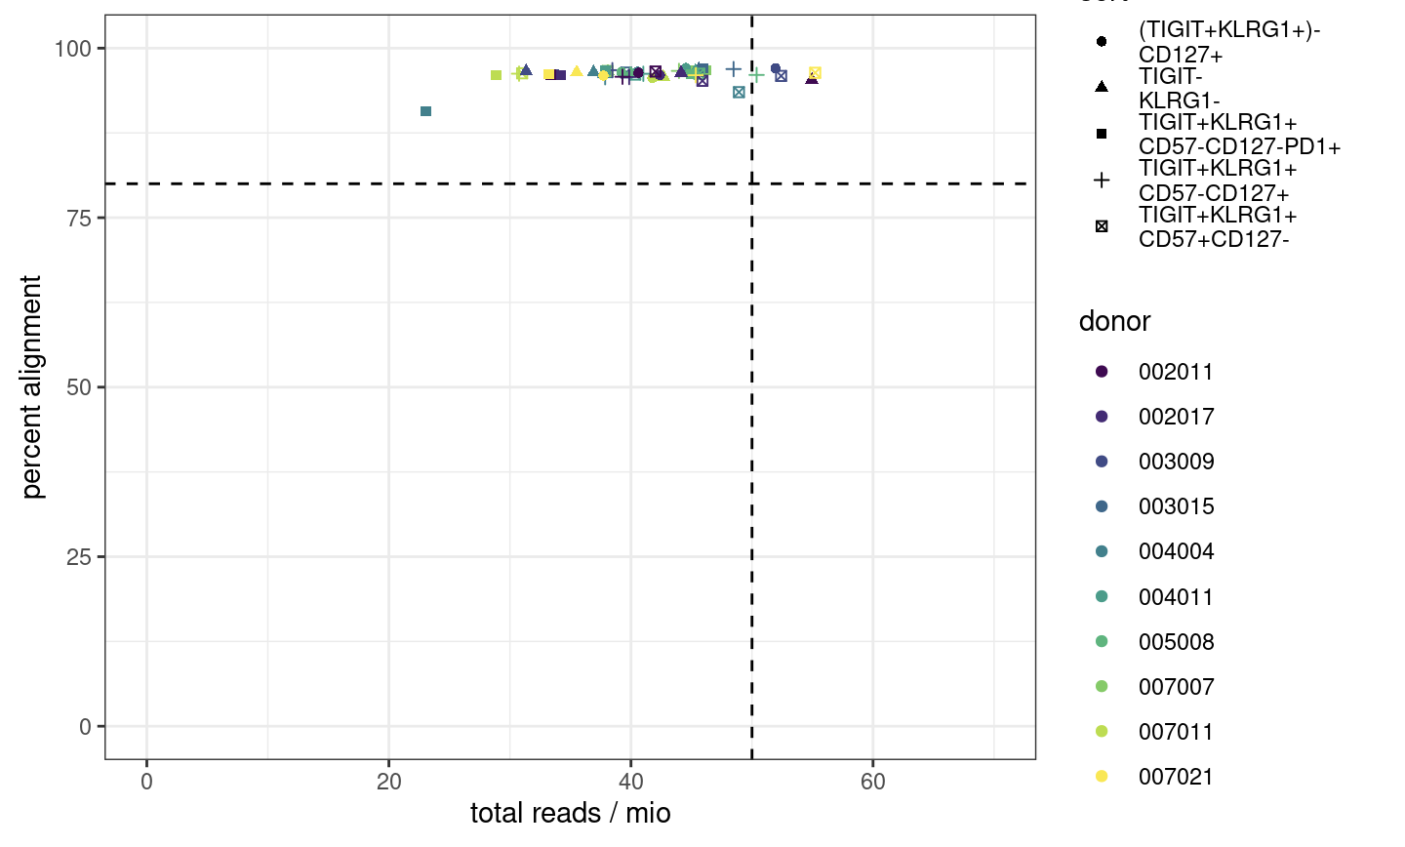
Few libraries have desired 50 million reads, alignment passes
Notes:
ENCODE recommends 50 mio (aligned) reads for paired-end, 25 mio for single read
ENCODE: each replicate should have 25 million non-duplicate, non-mitochondrial aligned reads for single-end sequencing and 50 million for paired-ended sequencing (i.e. 25 million fragments, regardless of sequencing run type). The alignment rate, or percentage of mapped reads, should be greater than 95%, though values > 80% may be acceptable
want 10-50 mil reads depending on if TF analysis required (ENCODE suggestions)
we now want our samples to fall into the top right corner
consequences: may have reduced sensitivity (for low abundance/rare stuff), increased noise, decreased reproducibility across replicates (i.e. within sort+responder groups)
P452 may have had more reads/library because less libraries for the flowcell… Vivian expected P576-1 reads average around 50M but they were on average lower…

Slide 37
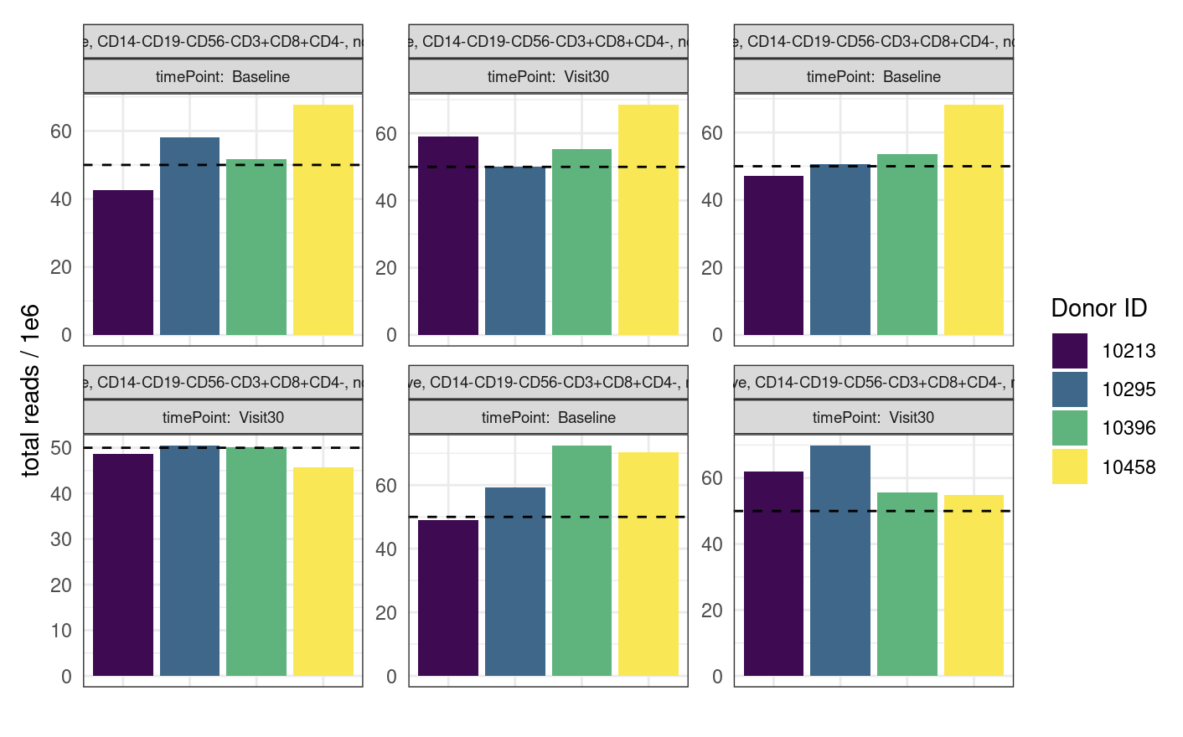
P452 QC comparable to that of P576-1 but does have more reads

Slide 38
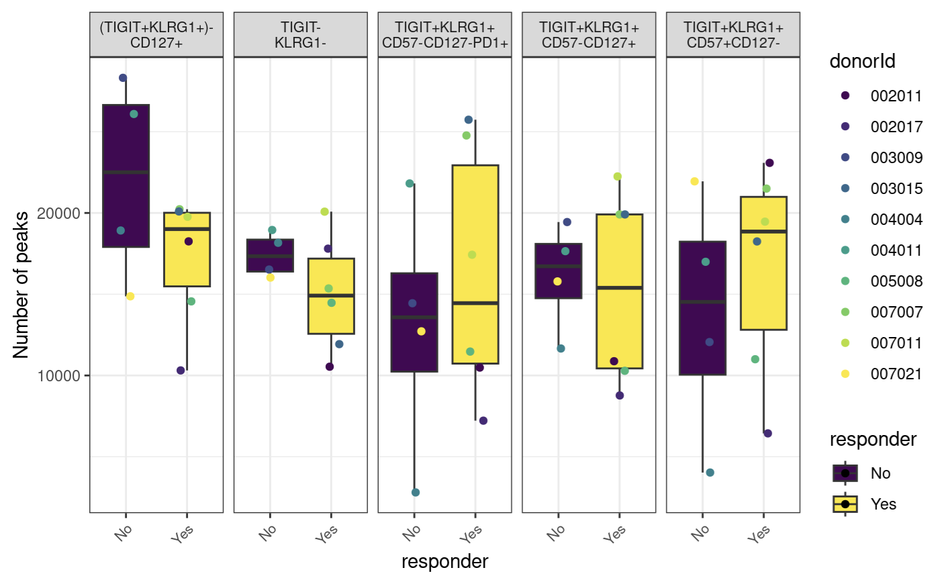
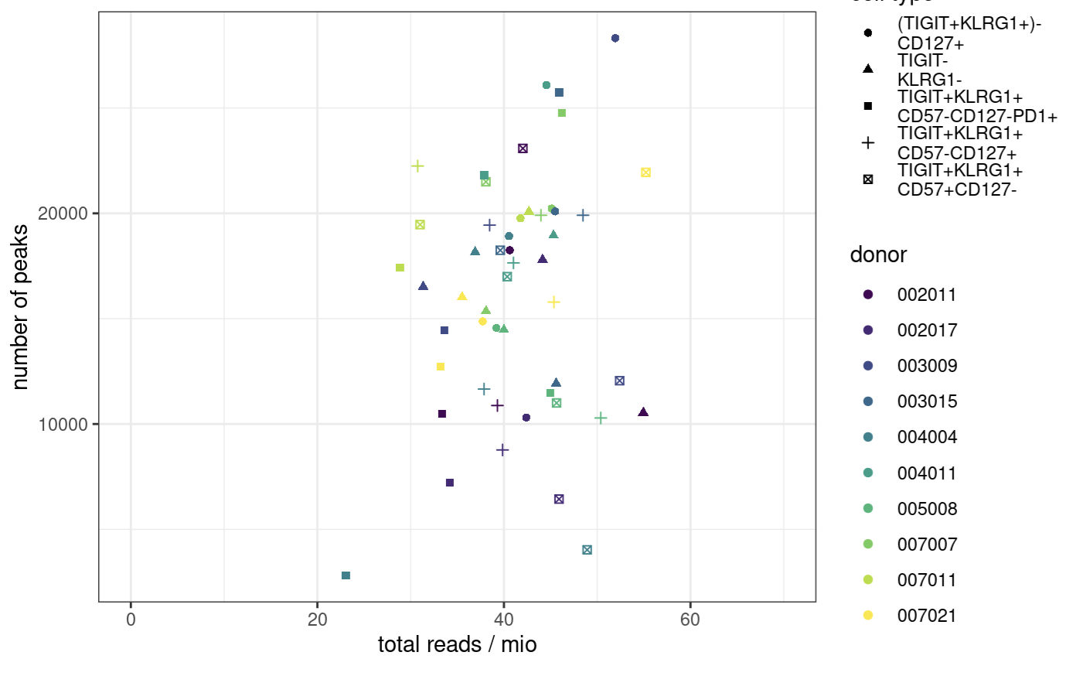
Peak counts
Notes:
ENCODE:The number of peaks within a replicated peak file should be >150,000, though values >100,000 may be acceptable.
ENCODE recommends > 150,000 peaks, although > 100,000 is still acceptable

Slide 39
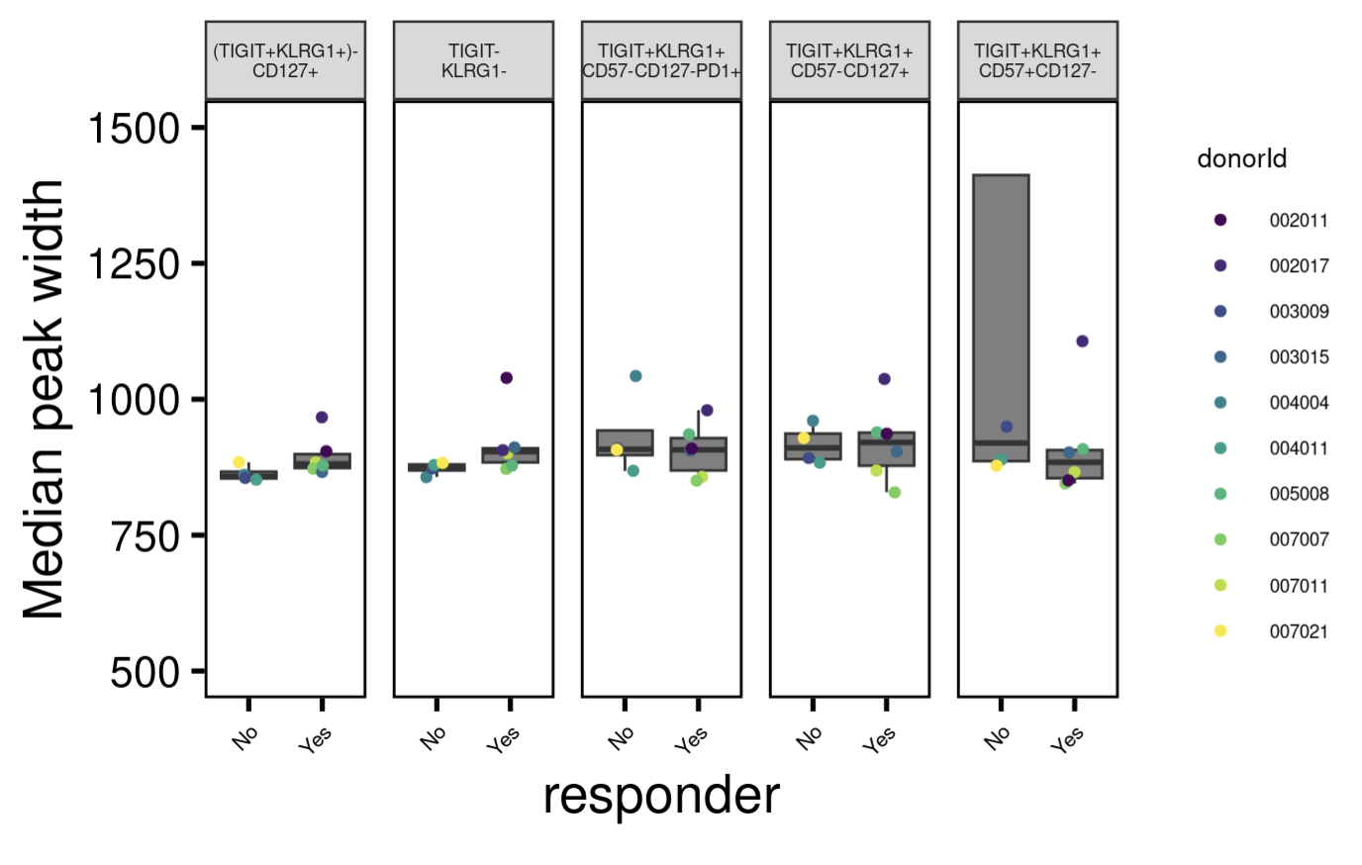
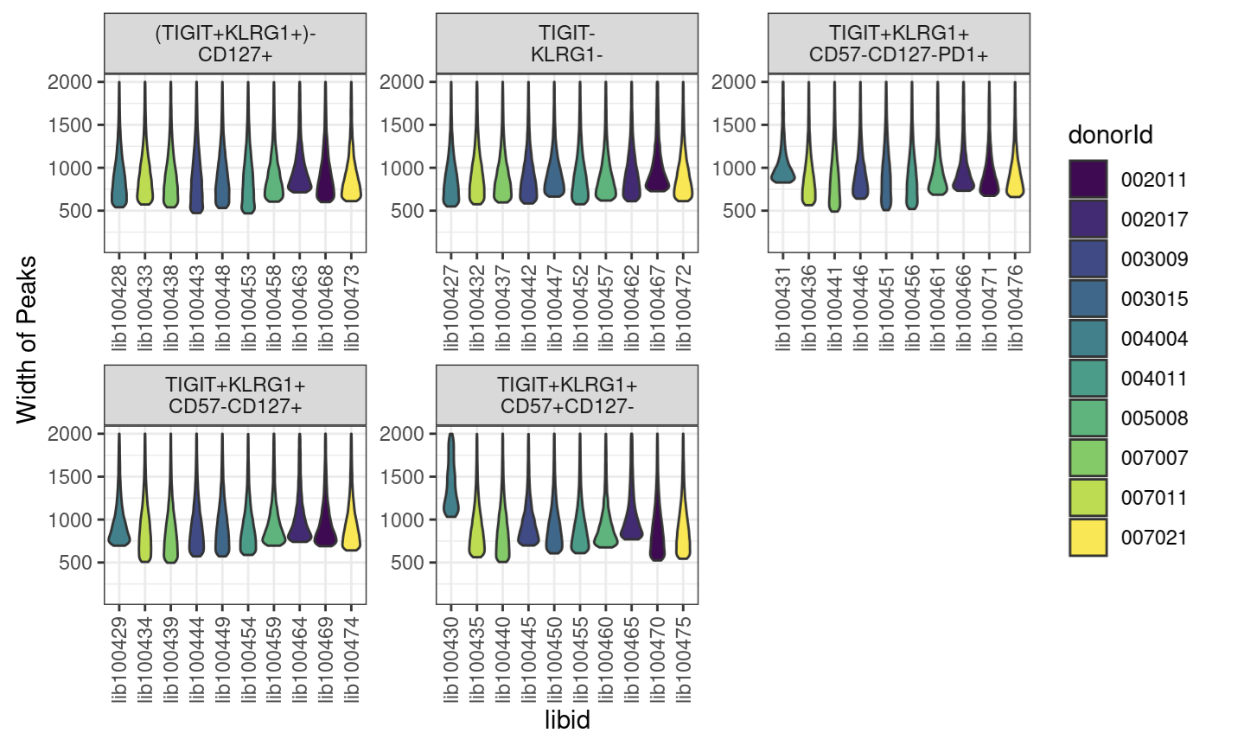
Peak widths
Notes:
want ~400-1000 bp peak widths as medians
libid100430 is wide peak one

Slide 40
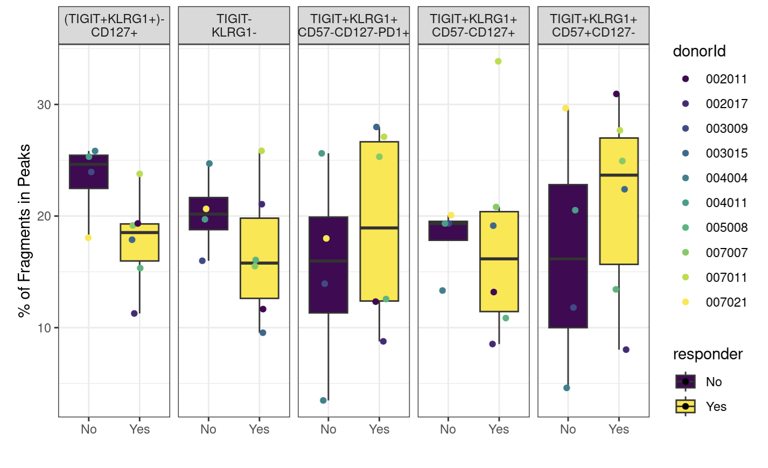
Fraction of reads in peaks
Notes:
ENCODE: The fraction of reads in called peak regions (FRiP score) should be > 0.3, though values greater than 0.2 are acceptable. TSS enrichment remains in place as a key signal to noise measure
FRiP is calculated by going through the bam files and counting the reads that fall within a called peak

Slide 41
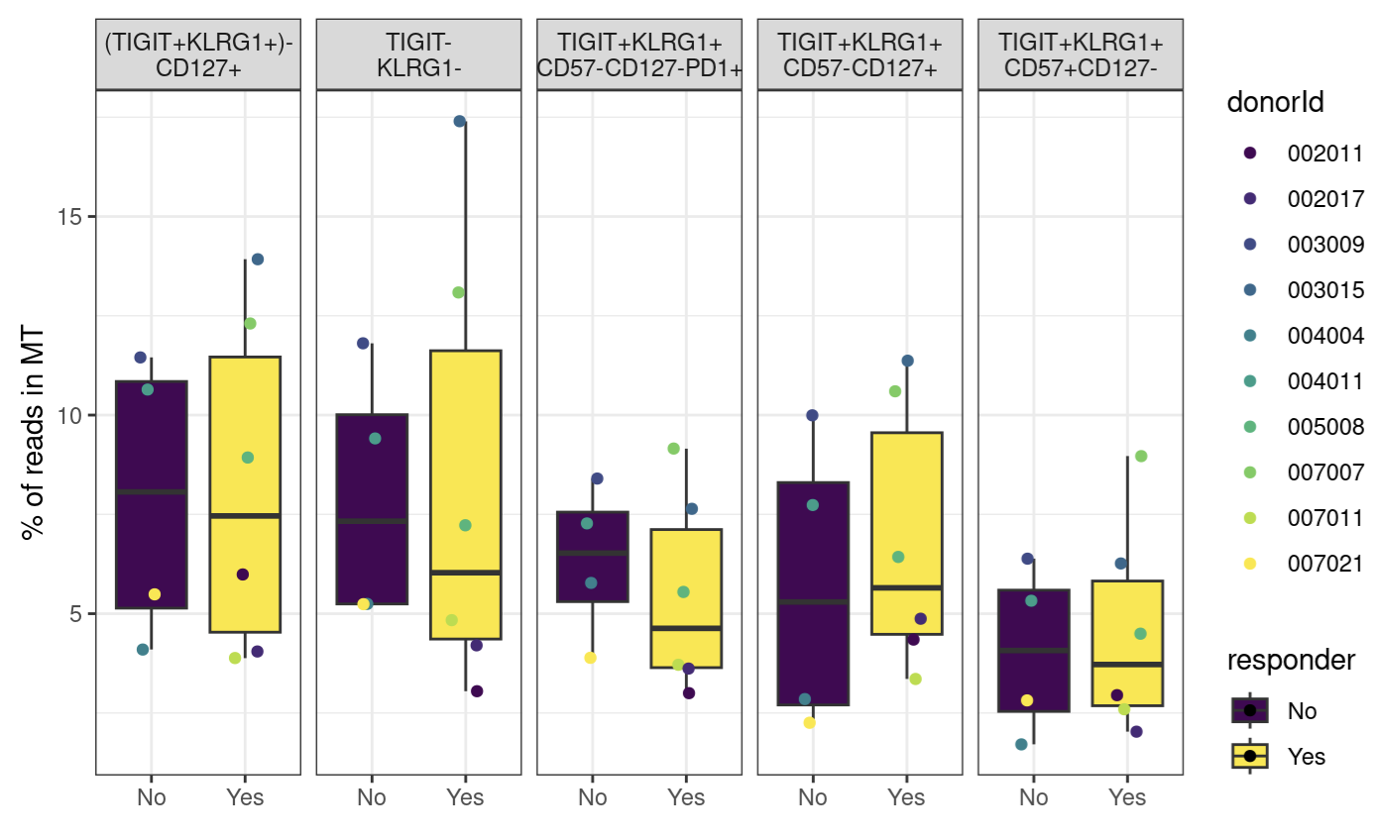
Percent of reads mapping to mitochondrial genome

Slide 42
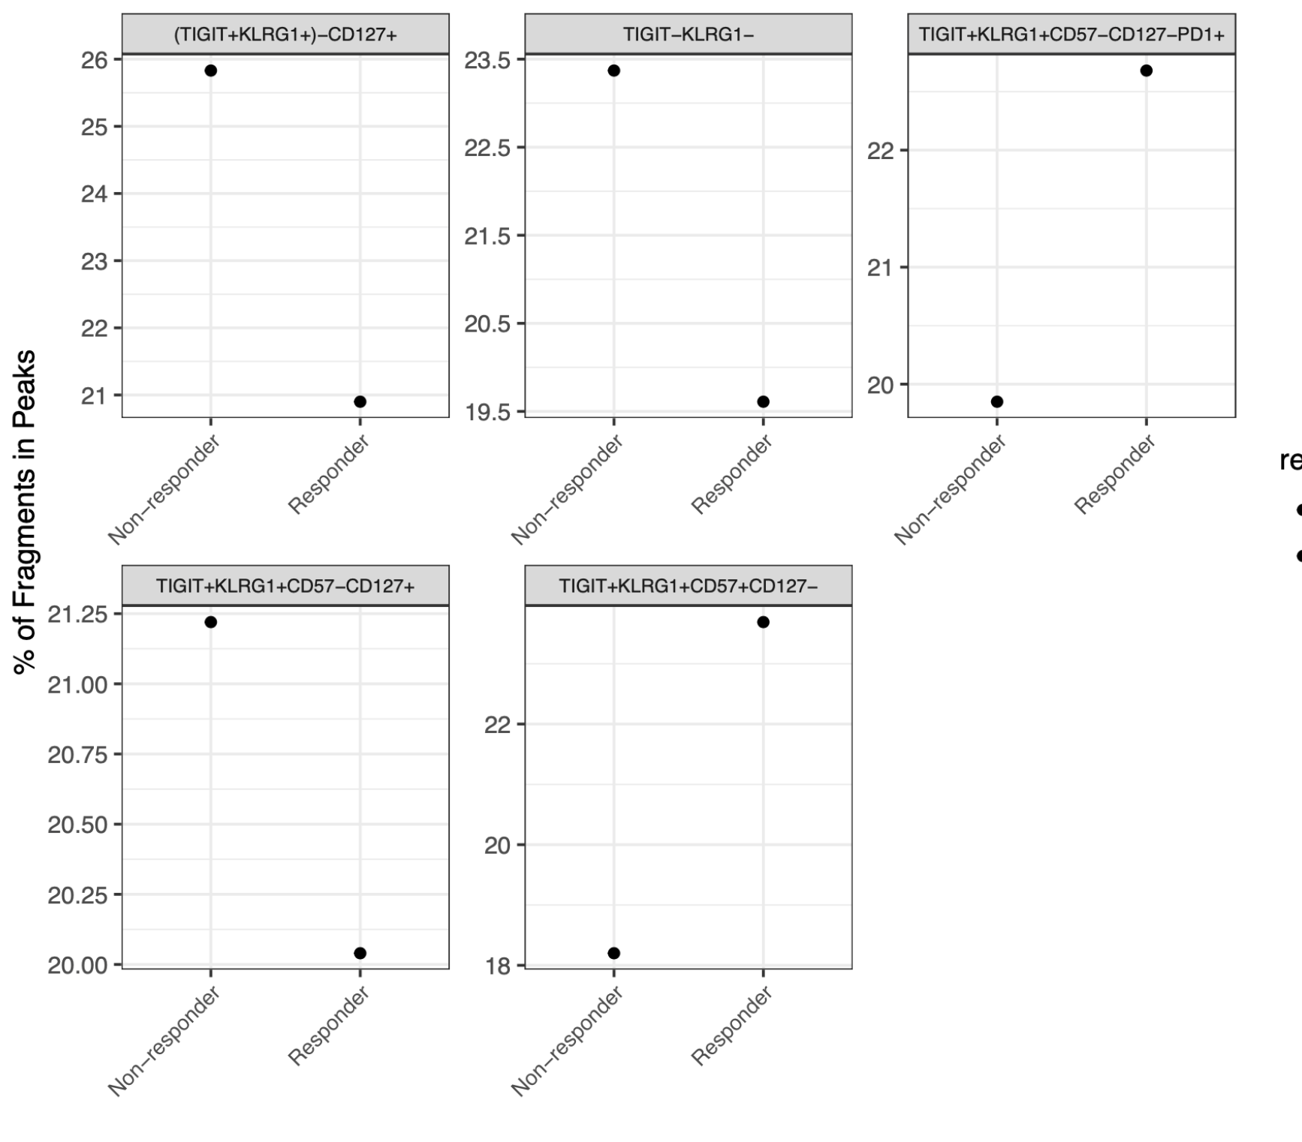
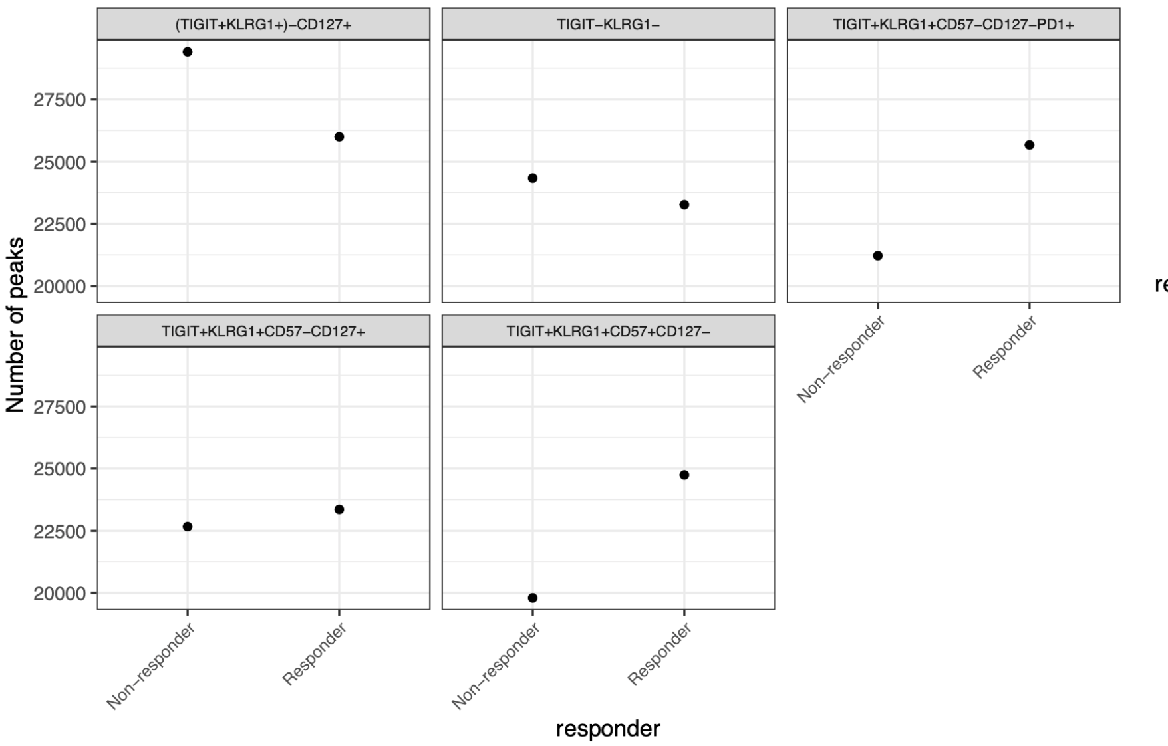
As expected, FRiPs are higher after merging alignment and peak files; peak counts are still lower than expected (still similar to P452)
Notes:
Merging:
Old Erin way: make the consensus peak set using peaks identified in at least two samples
New Stephan way: merged peaks from peaks called on merged alignment files by study group?

Slide 43
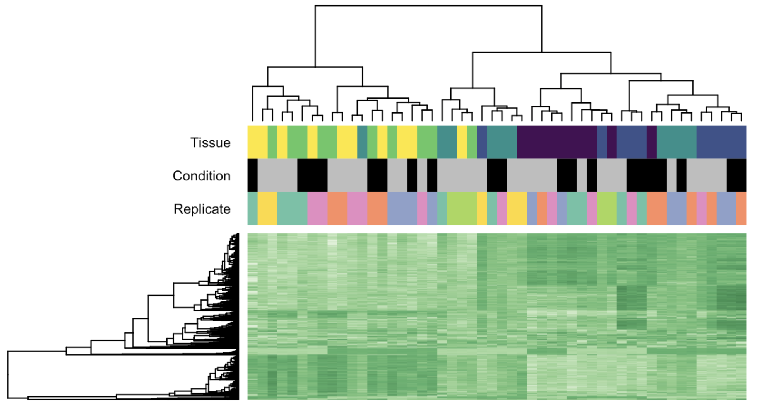
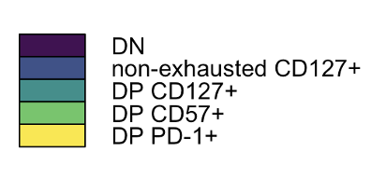
Cell population, rather than responder status, drives epigenetic differences
Cell population
Cell population
Responder status
Donor
Responder status
Non-responder
Responder

Slide 44
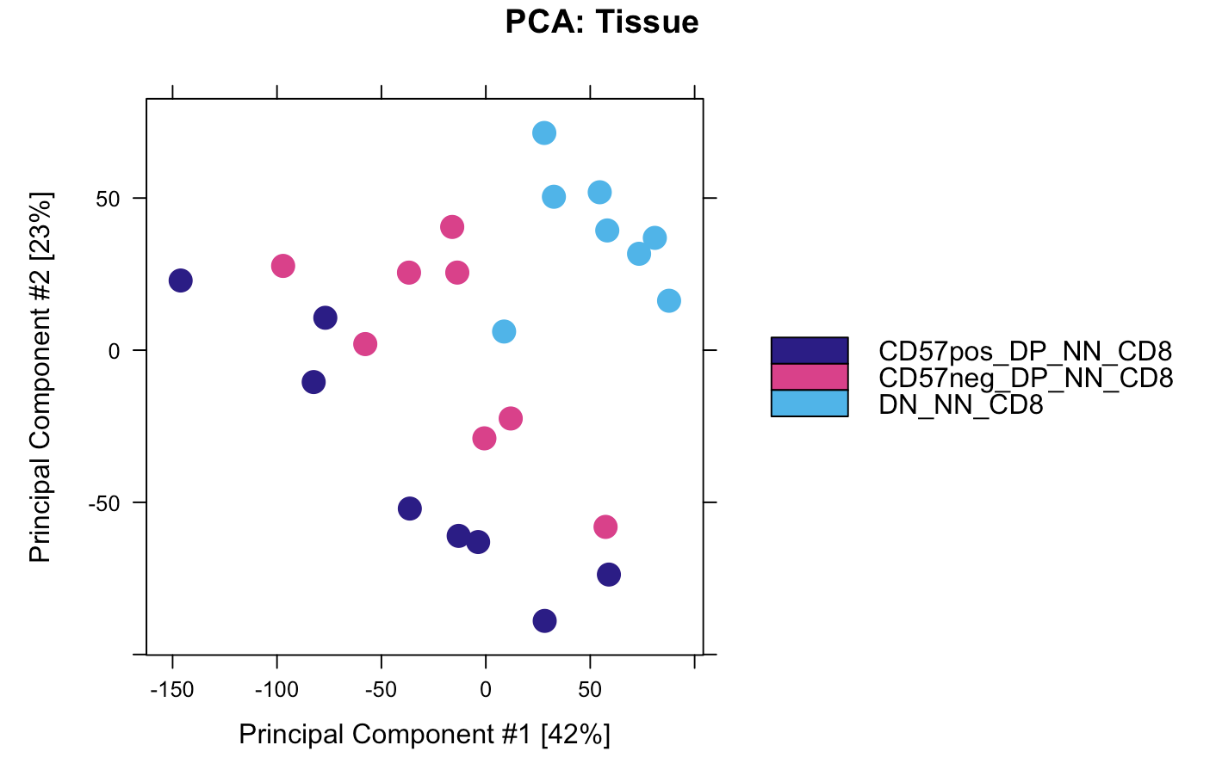
DP CD57⁺ and DP PD-1⁺ also cluster away from DN in P452, DP PD-1⁺ being more intermediate
Notes:
CyTOF data I think

Slide 45
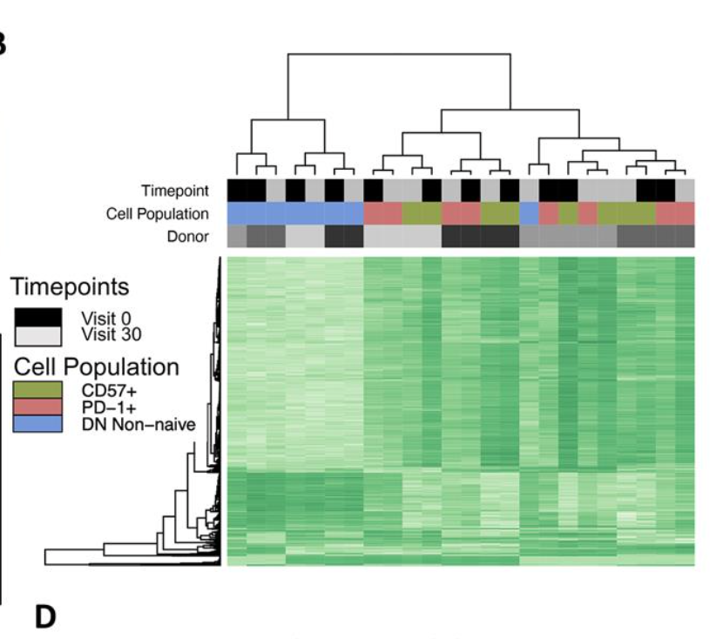
DP CD57⁺ and DP PD-1⁺ also cluster together away from DN in P452, timepoint does not drive clustering here

Slide 46
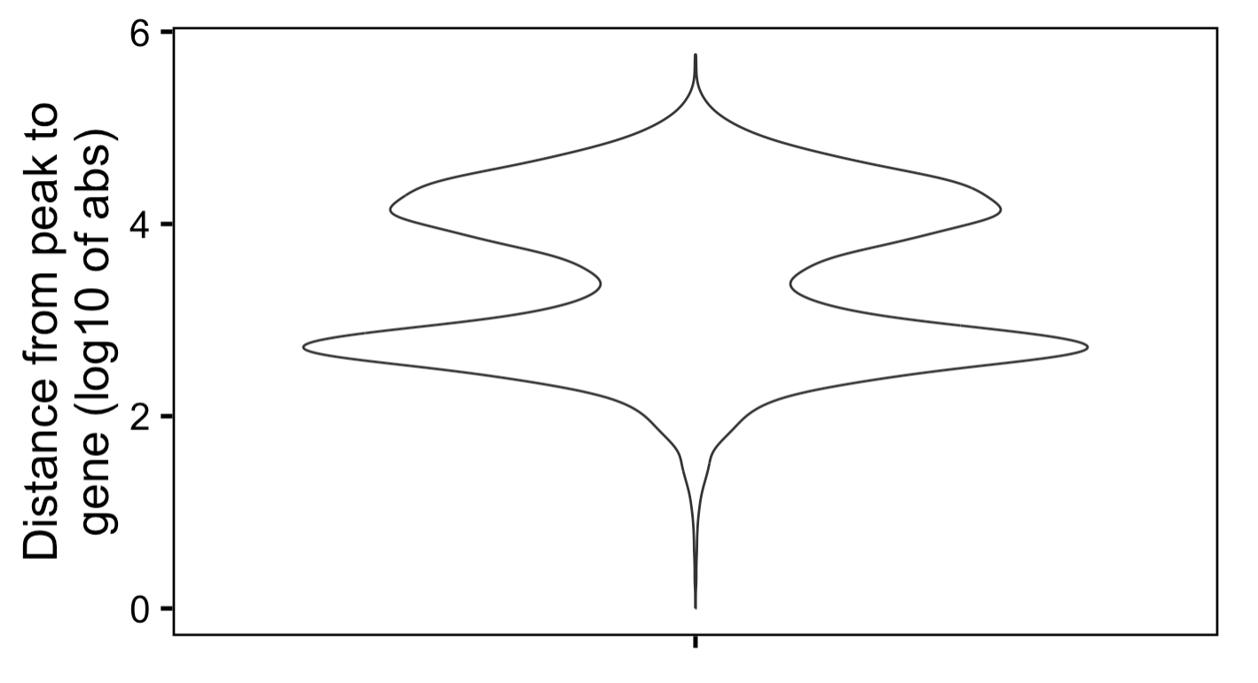
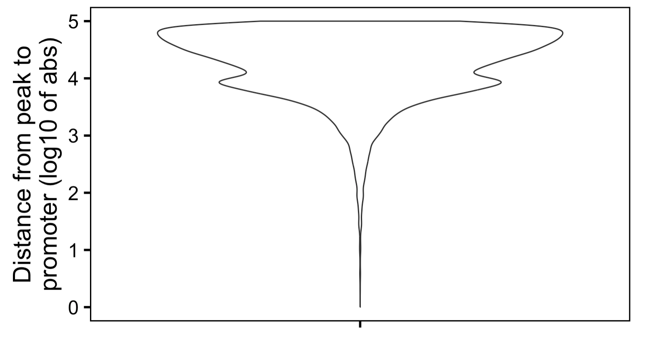
Most peaks are far away from genes (> 5 kb) and promoters (> 10 kb)
Notes:
This is from PD-1+ vs. DN contrast

Slide 47
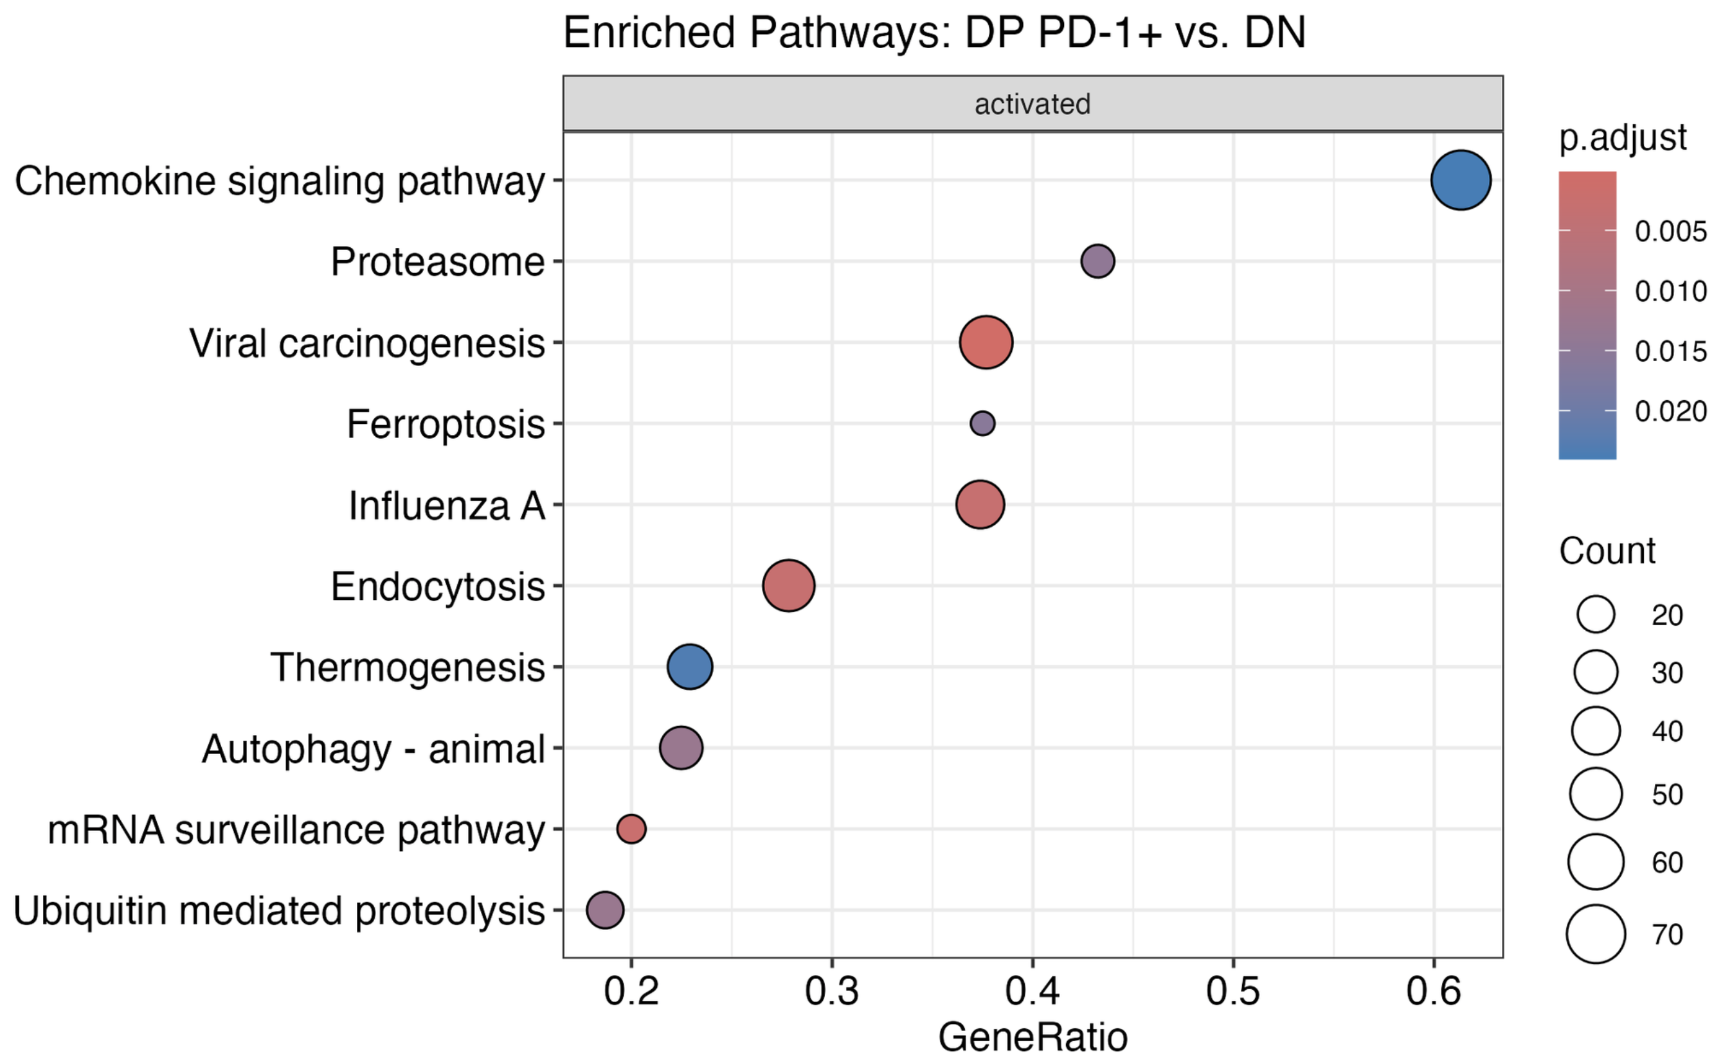
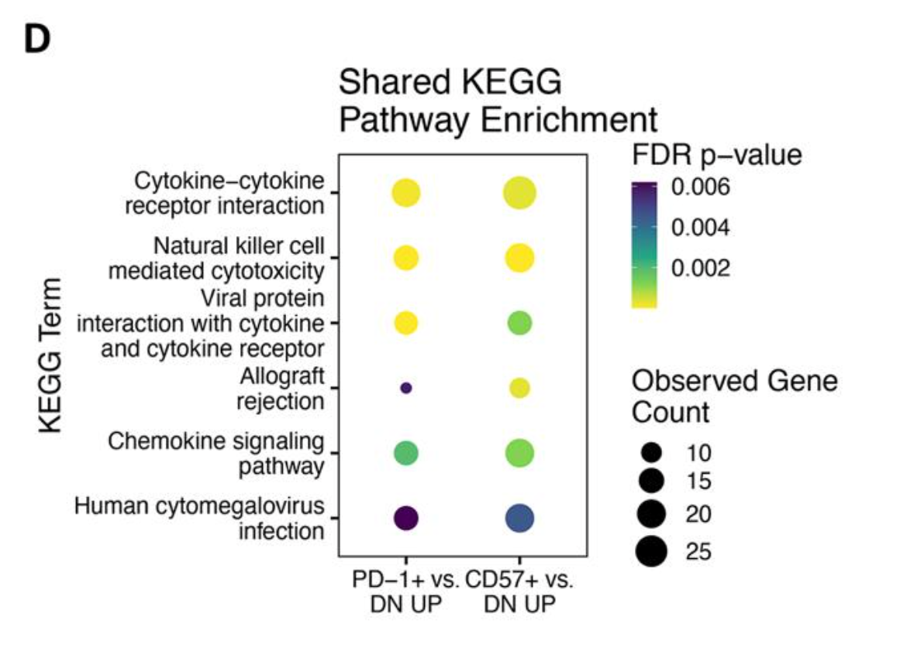
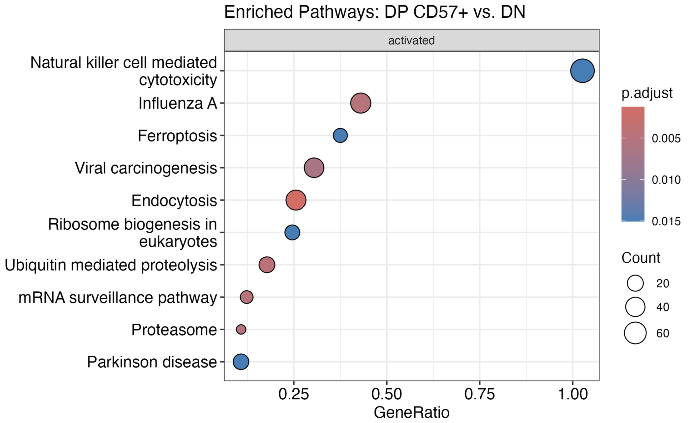
Comparison of KEGG analyses between projects
!
!
!
!
P576
P452 (Erin’s)

Slide 48
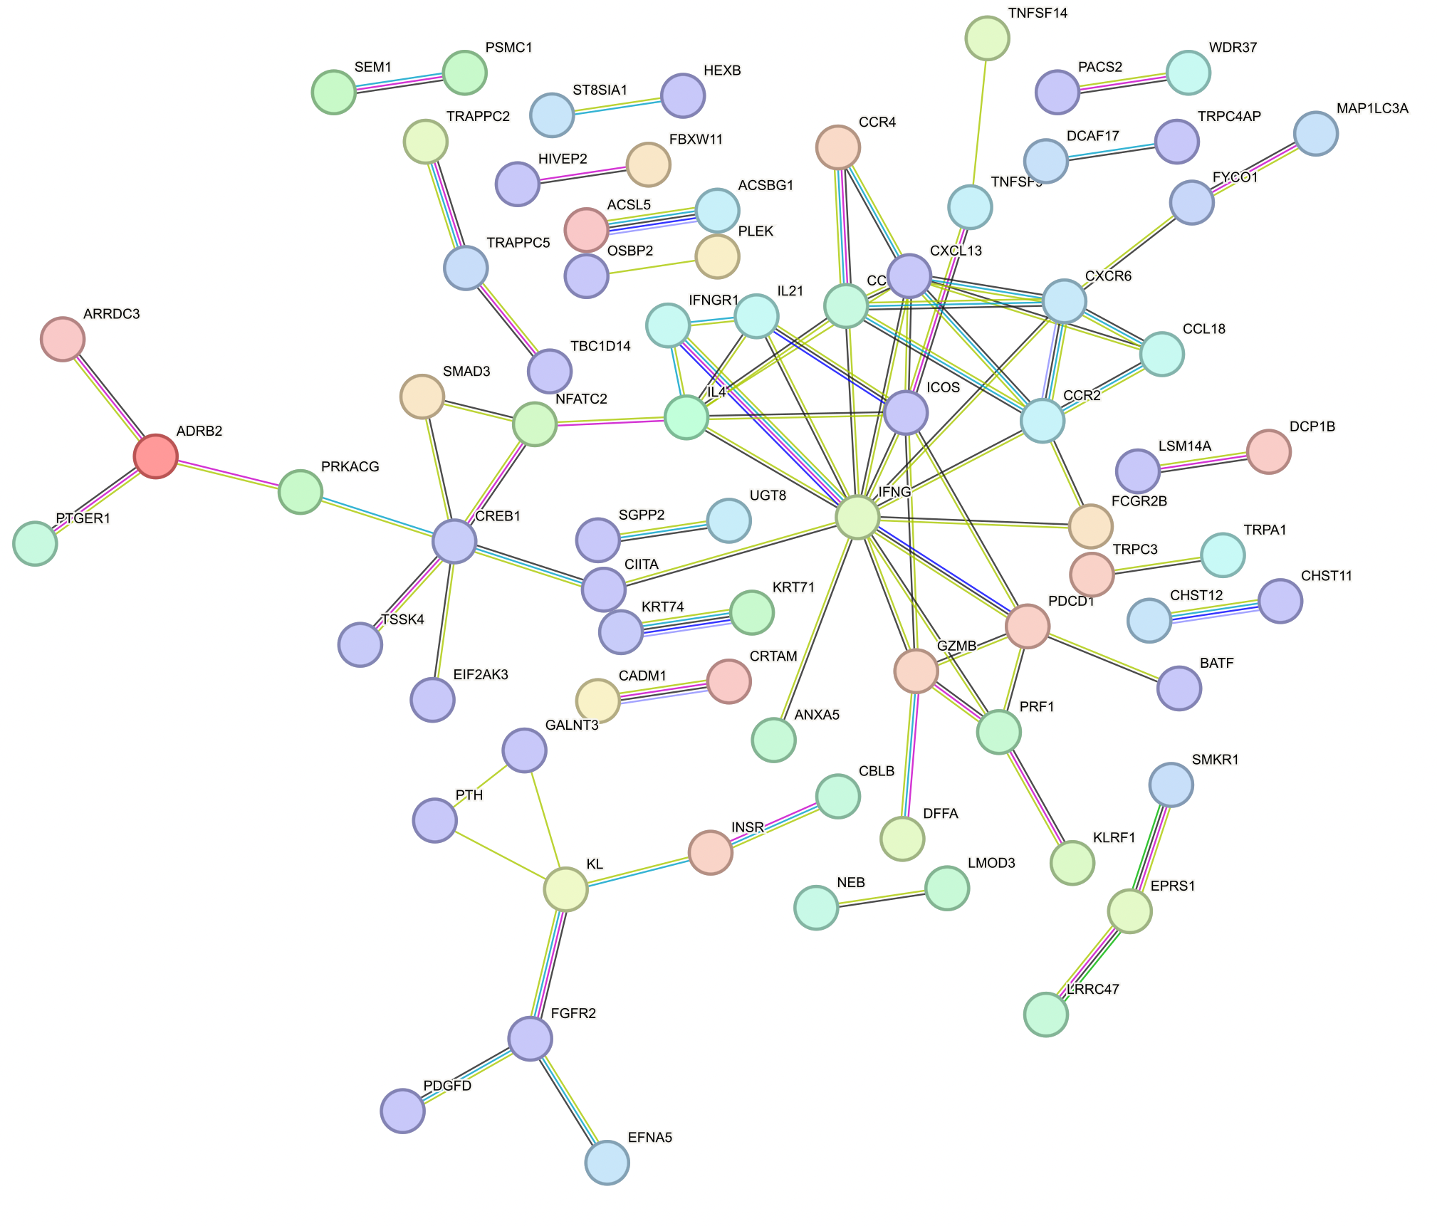
Central IFNG cluster in peaks’ genes up in DP PD-1⁺ vs. DN

Slide 49
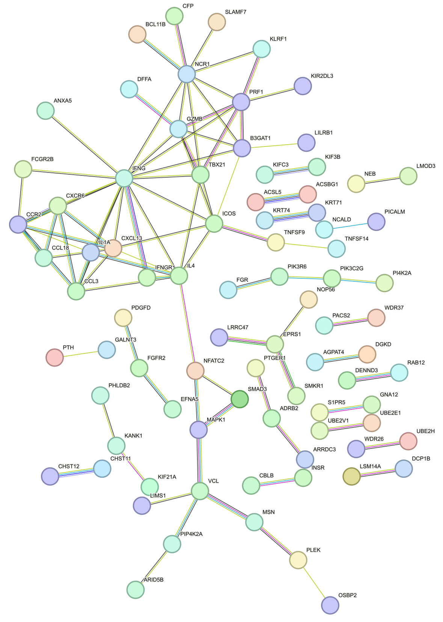
Central IFNG cluster in peaks’ genes up in DP CD57⁺ vs. DN

Slide 50
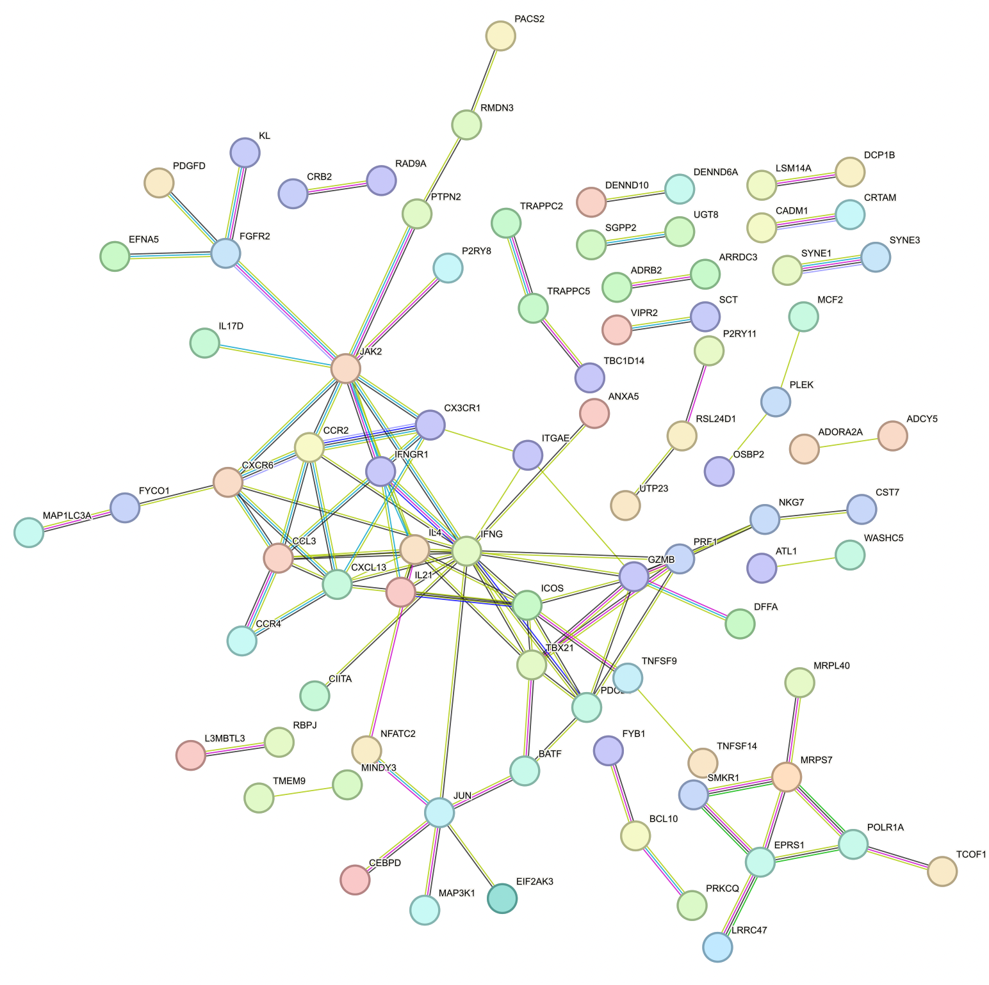
Central IFNG cluster in peaks’ genes up in DP CD127⁺ vs. DN

Slide 51

Similar PPI of peaks’ genes up in DP CD57⁺ vs. DP PD-1⁺ here as in Erin’s analyses

Slide 52

PPI of peaks’ genes up in DP PD-1⁺ vs. DP CD57⁺

